Slide 1
Understanding Cryptology: Cryptanalysis
Instructor name: Dr. Kerry A. McKay
Date of most recent change: 4/23/13

Slide 2
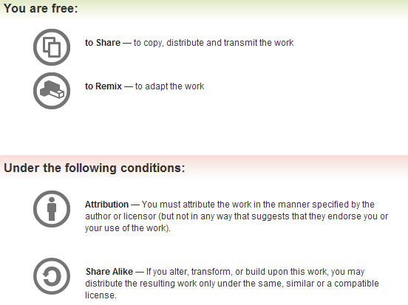
All materials is licensed under a Creative Commons “Share Alike” license.
http://creativecommons.org/licenses/by-sa/3.0/

Slide 3
Outline
Intro to this course
Human-computable crypto
Number theory and abstract algebra primer
Factoring attacks
Attacks on RSA
Discrete logarithm attacks
Symmetric system constructions
Generic attacks
Linear cryptanalysis
Differential cryptanalysis
Integral cryptanalysis on reduced AES
Conclusions and closing remarks

Slide 4
Goals
Learn about different techniques that are used to attack modern cryptosystems
Focus on deterministic algorithms
Implementation agnostic
At the end of this course, you will
Understand foundational mathematics that drive crypto designs and attacks, including topics in number theory, abstract algebra, linear algebra, and probability
Be able to identify appropriate methods of analysis based on algorithm class and properties
This does not mean that you will be able to break everything at the end of this course
But you will have a better idea of what you can and cannot do
You will have a better understanding what the bad guy can do
But if I won’t be able to break things, why am I here?

Slide 5
The real story
“In theory, theory and practice are the same. In practice, they are not.” (thank you Einstein)
Cryptologists work very hard to analyze systems in theoretical frameworks
Working under certain assumptions
Never underestimate people’s ability to do it wrong in practice
Poor parameter choices
Sacrifice something for better performance
Dependency on biased random number generator
Reuse of things that should never be reused
In general, break the assumptions under which the system was shown to be sufficiently secure
The “custom” crypto/obfuscation technique
Often weaker than their well-studied counterparts

Slide 6
The bottom line
You may be able to find the key or message in some scenarios
You will be able to better assess
Your needs when considering algorithms
Where a system’s security is lacking with respect to crypto

Slide 7
What to expect
We’ll start with a some human computable ciphers
Next we’ll jump into a brief math background
Hours of undergrad math condensed into a few slides
If you need your coffee to jump start your brain in the morning, you may want to fill that cup
We’ll be focusing mainly on generic methods of analysis
Widest application
There will be specific attacks as well
RSA is widely used and will be for a long time
Can keep increasing key length without changing algorithm design
Attack on reduced AES
This won’t work on the full version

Slide 8
When in doubt
If you have a question, please ask ☺
I have a tendency to drive right on if I get no feedback
Sometimes I forget that not everyone has the same set of knowledge as myself, and what I say only makes sense to me
Everyone knows Fermat’s little theorem, right?
No?
Riiiight… I know that because I’ve been studying cryptology for years
Discussion aids the learning process and is encouraged

Slide 9
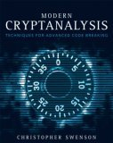
Textbook for this course
Modern Cryptanalysis: Techniques for Advanced Code Breaking
Swenson
Errata available at http://www.caswenson.com/mcerrata
This is a good book, and covers most of the material

Slide 10
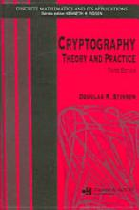


Further reference
Cryptography: Theory and Practice
Stinson
Introduction to Modern Cryptography
Katz, Lindell
Handbook of Applied Cryptography
Menezes, van Oorschot, Vanstone
The latest and greatest (through 1996)
Download chapters free online at http://cacr.uwaterloo.ca/hac/ (read the copyright notice)
Can fill in gaps of Swenson’s book
We’ll refer to it as “HAC” in this course

Slide 11
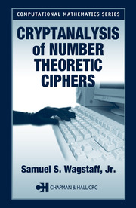

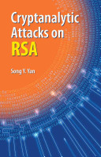
Further reference (continued)
Cryptanalysis of Number Theoretic Ciphers
Wagstaff
Applied Cryptanalysis
Stamp and Low
Attacks on RSA
Yan

Slide 12
Approximate Agenda
Day 1
Human-computable crypto
Number theory and abstract algebra primer
Factoring attacks
Attacks on RSA
Day 2
Discrete logarithm attacks
Symmetric system constructions
Generic attacks
Linear cryptanalysis
Day 3
Differential cryptanalysis
Integral cryptanalysis on reduced AES
Conclusions and closing remarks
Subject to change based
on how quickly folks get
through the exercises

Slide 13
The math
In Core Concepts, we took out as much math as possible to make it more accessible
We couldn’t do that here
Still tried to keep it accessible
Not in theorem and proof format
We will not go into excruciating detail*
Some of the math is essential to understanding
Some of the math is there to support that a technique has a reason to work
Technique can be used without full understanding of why it works
* For some definition of “excruciating detail”

Slide 14
Human-computable crypto
It is always good to start with the basics

Slide 15
Caesar cipher
Caesar cipher is a monoalphabetic cipher
Replace each symbol of the plaintext with a symbol of ciphertext using a single new alphabet
Suppose each letter is mapped to an integer index
A=0, B=1, …., Z=25
Encoding becomes a modular addition
Rotate indices by a constant integer, x
Example: D + Y = 3 + 24 = 27 ≡ 1 (mod 26)
Result is B
Decoding is the inverse
If encryption key is Y, decryption key is 26-Y
Decryption key is 2, or C
B + C = 1 + 2 = 3
Result is D, as expected

Slide 16
An alternative encoding approach
Can also just line up a plaintext alphabet and ciphertext alphabet
Replace character of plaintext alphabet with ciphertext character at the same position
Example
Plaintext: ABCDEFGHIJKLMNOPQRSTUVWXYZ
Ciphertext: FGHIJKLMNOPQRSTUVWXYZABCDE
HELLO becomes MJQQT
Both methods are equivalent
One takes more time
Negligible
The other takes more memory
Need to store two alphabet strings
This is going to be a running theme

Slide 17
Cryptanalysis of Caesar cipher
Easily breakable by anyone who knows the cipher algorithm
Worked OK back in the day
High illiteracy rate
Lack of algorithm knowledge
Attacks
Brute force
Try every possible key
Always an option
For a 26-letter alphabet, only 26 possible values for x
That’s doable
Frequency analysis

Slide 18
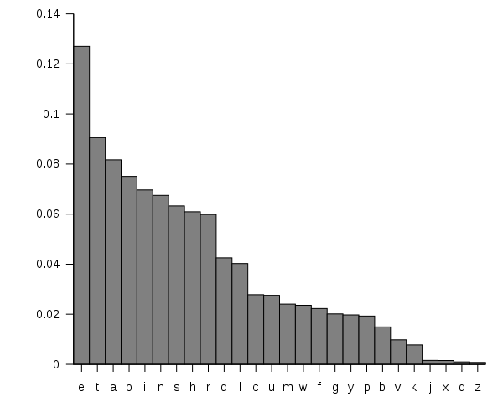
Frequency analysis
In every language, symbols occur with different probabilities
Frequency analysis looks at how often each is seen in a sample
Match frequency in ciphertext to frequency in plaintext
Gives a short list of possible mappings
Image from: http://upload.wikimedia.org/wikipedia/commons/b/b0/English_letter_frequency_%28frequency%29.svg

Slide 19
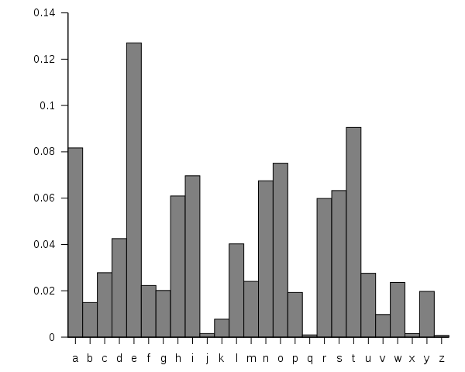
Example
Suppose you have a message encoded with the Caesar cipher
You count the number of times each symbol appears, and compute percentage
What letter goes with what?
F G H I J K L M N O P Q R S T U V W X Y Z A B C D E
Image from: http://upload.wikimedia.org/wikipedia/commons/d/d5/English_letter_frequency_%28alphabetic%29.svg

Slide 20
Exercise
Time to get down to some python
Partial code (and completed) code available in my transfer folder
Partial code has it started for you
Provided code is not always efficient
Goal was understanding, not efficient programming
Copy the folder “exercises” to your local machine
Right-click on caesar.py and select “Edit with IDLE” to open

Slide 21
Everything you need to know about python (for this course)
Right-click on pythonCrashCourse.py and select “Edit with IDLE”
Opens file in a python editor
Press F5 to run your code
Python structure is dictated by whitespace
No braces
Code with same indentation is at the same level
Loop/conditional body needs to be indented
pythonCrashCourse.py contains examples of:
For and while loops
If statement
Print statements
List manipulation
Random integers

Slide 22
IDLE
IDLE tips
To indent (shift right) a block of code, highlight and press ctrl+]
To dedent (shift left) a block of code, highlight and press ctrl+[
To comment a block of code, highlight and press alt+3, or got to format menu
To uncomment a block of code, highlight and press alt+4, or got to format menu

Slide 23
Lab 1: Caesar cipher
Objective: Attempt to find the plaintext by
Frequency analysis
Brute force
You’ll need to fill in the following functions
frequency
relativeFrequency
decrypt
Finished early?
Write an encryption routine as well
Encrypt different messages, and see how the frequency analysis changes with the length of the message

Slide 24
Polyalphabetic ciphers
Monoalphabetic cipher applies the same key to every symbol
Polyalphabetic cipher switches between a set of keys
The next step up from monoalphabetic systems like Caesar’s cipher
We’ll look at the Vigenère Tableau
Symbols are changed exact same way as Caesar’s cipher
Difference is that there are multiple key symbols

Slide 25
Vigenère Tableau
There is a table on page 8 of the text
If symbols are represented numerically, can condense into a simple expression
P[i] + (k[i mod len(k)])
The second part selects the correct key symbol to use
If you do this, watch out for the spaces
If they aren’t in the alphabet, they should be ignored
Example:
Plaintext: “the quick brown roman fox jumped over the lazy ostrogoth dog”
Key: “caesar”
Result: “vhi iuzek fjonp rseae hob budreh gvvt tlw lrby sktiqgslh uqg”
Spaces may preserve plaintext word length, or may occur at fixed intervals to obscure word length

Slide 26
Attacking the Tableau
Step 1 is to figure out the key length, n
Look for patterns
Common words are likely to be encrypted multiple times if the text is long enough
“the” is very common in English
If there are at least n occurrences of “the” in the plaintext, we can expect at least 2 to have identical ciphertext
When you find two words of ciphertext that you believe to encrypt the same ciphertext
Find the difference in position, d
n|d
Repeat and narrow in on n by looking for common factors

Slide 27
Example
KKALC LGQLC CREFC KVMPW BSURR ZUZMH PWZJO ZFHIF
FBMAV VFQAS COKSI IGOIB VTDSA RBOMS EHSVI UUQFF
VOWXC ESIQI KWZCK YSDIQ ZJUPP CCAHA RYQWQ ZJUPV
RBPWI EQXIO ETDSA WCDXV KVQJO KOXPC ZBEST KVQWS
KKAJC VGMTO ZFAJG KODGF FGEHZ FJQVG KOWIH YSUVZ
Spaces occur at fixed intervals
Look for any repeated groupings
KKA (0,160)
OZF (34,169)
TDSA (61,131)
QZJUP (99,114)
KVQ (140,155)
GKO (174,189)

Slide 28
Example (continued)
Find the differences between pairs and factor
160 – 0 = 160 = 2⁵ * 5
169 – 34 = 3³ * 5
131 – 61 = 70 = 2 * 5 * 7
114 – 99 = 155 – 140 = 189 – 174 = 15 = 3 * 5
Identify common factors
They all have 5 as a factor
Since 5 is a prime and the key has an integer length, we know n=5
If the only factor is composite, it may be the key length or a multiple of the key length
Split the ciphertext by key character and perform frequency analysis

Slide 29
Example (continued)
Let’s look at how to find the first letter of the key
Conveniently, the groupings have the same length as the key
Just take the first letter of each group
KLCKBZPZ FVCIVZREU VEKYZCRZ REEWKKZK KVZKFFKY
Find the frequencies and relative frequencies
Sort letters by most likely
Use a frequency table to create a short candidate list
e is the most common letter in English, so we expect it near the top
It might be mapped to k, z, e, v, c, f, or r
This would mean the first character of the key is g, v, a, r, y, b, or n, respectively
Try the same with another top letter, such as t
Most likley key letters now are r, g, l, c, j, m, y
Both e and t show that g, r, and y as likely for the first key letter
k | 0.219512
z | 0.170732
e | 0.097561
v | 0.097561
c | 0.073171
f | 0.073171
r | 0.073171
y | 0.04878
b | 0.02439
i | 0.02439
l | 0.02439
p | 0.02439
u | 0.02439
w | 0.02439
a | 0
d | 0
g | 0
h | 0
j | 0
m | 0
n | 0
o | 0
q | 0
s | 0
t | 0
x | 0

Slide 30
Example (continued)
You can try this with a couple more common letters if you’d like, but this is a good short list
Repeat this for the other four key characters and try to decrypt with different combinations of your top characters for each key position
What you’ll find is that when you decrypt with “romeo” you get the following message
twoho useho ldsbo thali keind ignit yinfa irver
onawh erewe layou rscen efrom ancie ntgru dgebr
eakto newmu tinyw herec ivilb loodm akesc ivilh
andsu nclea nfrom forth thefa tallo insof these
twofo esapa irofs tarcr ossdl overs taket heirl
two households both alike in dignity in fair
verona where we lay our scene from ancient grudge
break to new mutiny where civil blood makes civil
hands unclean from forth the fatal loins of these
two foes a pair of starcrossd lovers take their l

Slide 31
Exercise
Open tableau.py in IDLE
There is a string in the variable ciphertext
The spaces have been preserved
Tasks
Implement Vigenère decryption in decrypt
Perform the attack just described (you may do some of it by hand)
Goal: find the plaintext and key
Hints
To handle the spaces, try creating a second string that is the message without spaces
Encrypt/decrypt using this list
When you output your result, use the original list to put the spaces back in

Slide 32
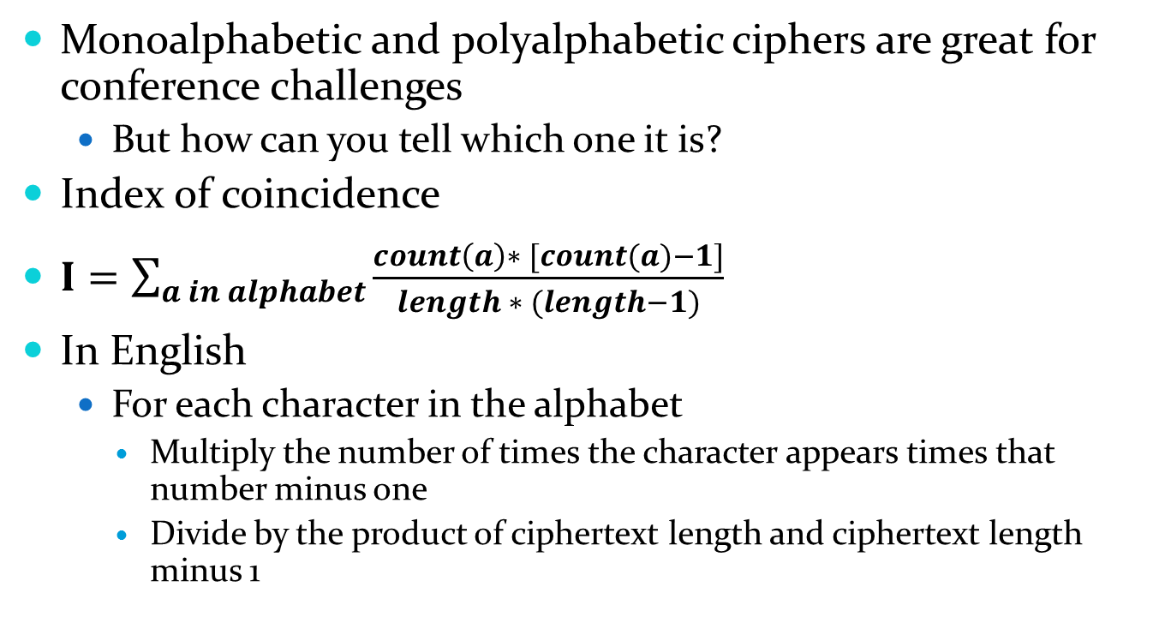
So I’m at Shmoocon and there’s this puzzle…
Monoalphabetic and polyalphabetic ciphers are great for conference challenges
But how can you tell which one it is?
Index of coincidence
$I=\sum_{a in alphabet}{\frac{count\left(a\right)∗ [count(a)−1]}{length ∗ (length−1)}}$
In English
For each character in the alphabet
Multiply the number of times the character appears times that number minus one
Divide by the product of ciphertext length and ciphertext length minus 1

Slide 33
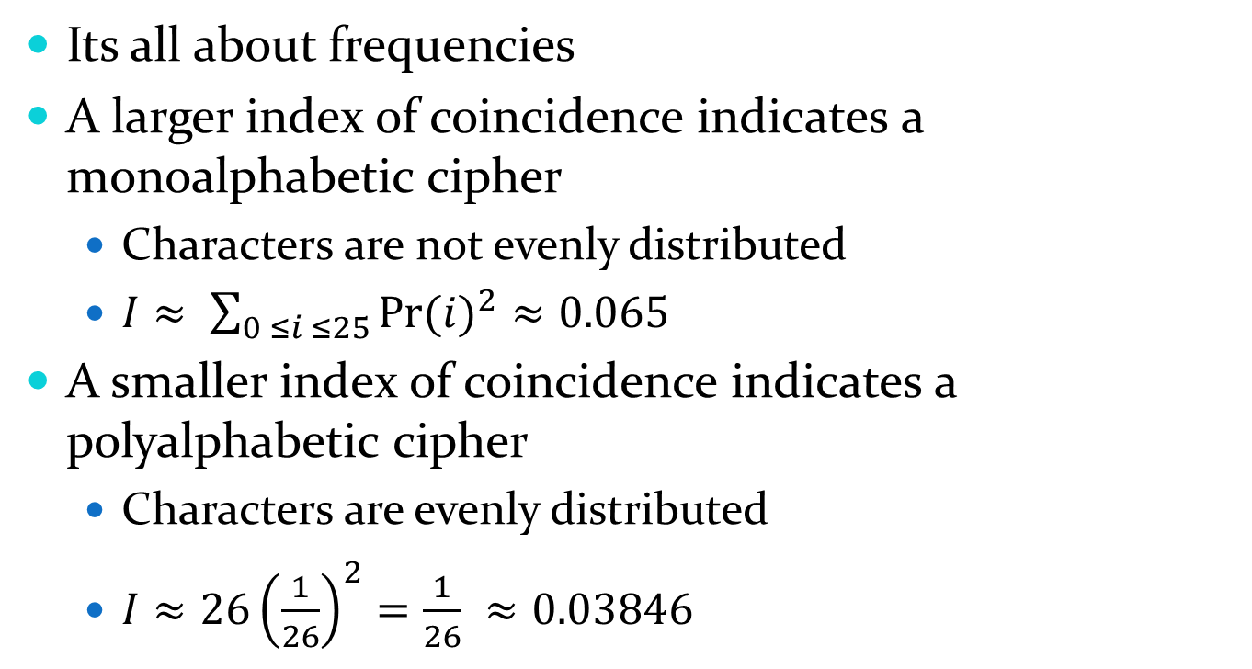
Index of coincidence
Its all about frequencies
A larger index of coincidence indicates a monoalphabetic cipher
Characters are not evenly distributed
$I≈ \sum_{0 ≤i ≤25}{{Pr⁡(i)}^{2}≈0.065}$
A smaller index of coincidence indicates a polyalphabetic cipher
Characters are evenly distributed
$I≈26{\left(\frac{1}{26}\right)}^{2}=\frac{1}{26} ≈0.03846$

Slide 34
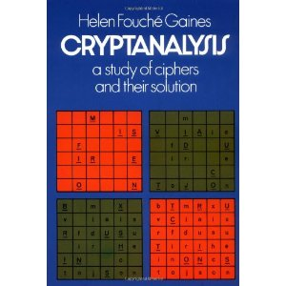
And many more!
Although these are probably the most likely to show up in a text book, they are not the only ones
There are a couple more in the course text
If you are interested in learning more about human-computable ciphers and attacks, check out “Cryptanalysis: a study of ciphers and their solution”

Slide 35
Attack Models and Metrics

Slide 36
Dimensions of attacks
It can be difficult to compare attacks and definitively say that one is better than another
May be comparing apples to oranges
There are several dimensions to an attack
Attack model
Data complexity
Time complexity
Memory (space) complexity

Slide 37
Oracles
Oracle
Something that you query, and it returns a response based on your query
Encryption oracle returns the ciphertext of the given plaintext
Decryption oracle returns the plaintext of a given ciphertext (or an error)
The oracle does not release the key, and the attacker need not know the key to query the oracle
Examples
Smartcards
TPM

Slide 38
What is an adversarial model?
Puts bounds on what the adversary can and cannot do
Can she query an encryption or decryption oracle, or only observe?
Can she obtain plaintext?
Known plaintext attack (KPA)
Know plaintext and corresponding ciphertext
Chosen plaintext attack (CPA)
Access to encryption oracle
Chosen ciphertext attack (CCA)
Access to decryption oracle
Ciphertext-only attack (COA)
No access to oracle
No corresponding plaintext

Slide 39
Ordering
Intuitively, it may seem that a stronger adversary should be capable of the same attacks that a weaker adversary is
Not necessarily true
Example: CCA
Some systems do not return decryption results (plaintext) if an error is detected
Attacker can use error messages to find the key, but does not have access to plaintext
Cannot mount a known plaintext attack
“Stronger adversary” means the adversary has more control
CPA adversary is stronger than KPA
Can query oracle
Compare by attacker capability

Slide 40
How are attacks compared?
Adversarial model is only one part
Three other factors used to compare:
Time
Number of evaluations of the function required (e.g. # times encrypt(x) is called)
Memory
How many cipher states and/or candidate keys need to be stored?
Data
How many ciphertexts or plaintext-ciphertext pairs are needed?
In cryptanalysis research, may also be a parameter for rounds
How much the cipher was reduced to perform analysis
Start with significant reduction, progress to full cipher
Useful in research, but not as important in practice
When attacks get close to full cipher, then becomes important

Slide 41
Which is better?
 | Model | Time | Memory | Data
Attack1 | CPA | 2³² | 2⁶⁴ | 2⁴⁹
Attack2 | CPA | 2^{31.5} | 2⁷⁵ | 2⁵⁰
Attack3 | KPA | 2⁸⁵ | 2¹³⁰ | 2³²
Attack4 | KPA | 2¹²⁰ | 2¹⁰ | 2¹⁸⁰
Attacks in one model are not always directly comparable to those in another model
Adversary has different abilities
Between attacks in same model, different dimensions are better than others
The best attack in a particular situation depends on what you have available to you

Slide 42
Choosing
You do not look for “the best” attack and try to meet its requirements
You look at the best you can do given your limits
What your capabilities are
Choose corresponding model
What data you have or can obtain
Gives you max data complexity
How much memory do you have available
Gives you max memory complexity
This often not in bytes, but in keys or states (multiple bytes)
Be sure to adjust accordingly
Then all that is left is time complexity

Slide 43
Number theory & abstract Algebra
A brief introduction

Slide 44
The basics
Prime and composite
Divisibility
Greatest common divisor (GCD)
Congruence
Groups, rings, fields
Unless otherwise specified, we’ll be working with integers

Slide 45
Terminology
Let’s begin by answering the following questions to make sure that we’re all speaking the same language
What is a prime?
What is a composite?
Is 1 prime, composite, or am I being tricky?

Slide 46
Terminology answers
A prime is a natural number greater than one that cannot be expressed as a product of any numbers other than one and itself
A composite is a natural number that is a product of primes, rather than being a prime
One is neither a prime nor a composite
It is a special number called the unit
In number theory, and therefore cryptology, it is not

Slide 47
Divisibility
A/B, B>0
A = qB + r
Integer quotient q
Integer remainder r (0 ≤ r < B)
This is the division theorem
If r = 0, then A = qB
B divides A
Written B|A

Slide 48
More properties
Divisibility is transitive
If a|b and b|c, then a|c
b = q₁a, c = q₂b
c = q₂q₁a
c = qa (here q=q₂q₁)
If a|bc, must it also be true that a|b or a|c?

Slide 49
Divisibility of products
If a|bc, must it also be true that a|b or a|c?
Let’s get a feel for this by examples
Example 1: a=2, b=2, and c=10
It is true that 2|20
It is true that 2|2 and that 2|10
So far, it looks good
Example 2: a=4, b=2, and c=10
It is true that 4|20
It is not true that 4|2 or 4|10
Ok, so clearly it isn’t always true
As it turns out, a|bc implies that a|b or a|c only when a is a prime
We saw in example 2 that when a is composite, its primes may be split between b and c
Notes:
20 = 2*2*5

Slide 50
GCD
Greatest common divisor, written gcd(a,b)
Largest number g such that g|a and g|b
Always positive
May be any natural number
Trick questions
gcd(-x, x) = x
gcd(-5, -10) = 5
gcd(0,0) = ?
This one may vary by the rules you are following
Undefined or 0

Slide 51
Congruence
Computers implement finite number systems
A byte can only store {0,…,255}
A 32-bit word can only store {0,…,2³²-1}
BIGNUM is limited to available memory
What happens to numbers outside those ranges?
Mapped to a congruent value
a and b are congruent mod n iff n|(a-b)
The distance between a and b on the number line is a multiple of n
Write a ≡ b (mod n)
n is called the modulus
If a ≡ b (mod n), then (a-b) = qn by division theorem
Notes:
When n is a power of 2, x mod n is the lg n least significant bits of x

Slide 52
Congruence examples
Let n=3
Then:
{…,-9,-6,-3,0,3,6,9,…}
3q+0
{…,-8,-5,-2,1,4,7,10,…}
3q+1
{…,-7,-4,-1,2,5,8,11,…}
3q+2
-9 ≡ 6 (mod 3)
They are in the same congruency class
6 – (-9) =15 is a multiple of 3
8 ≡ 11 (mod 3)
Each class is represented by the remainder (or residue): 0, 1, or 2
8 mod 3 = 2
Notes:
Try visualizing it with a number line

Slide 53
Congruence and operations
Can use congruent numbers interchangeably in calculations
Let n=25
94+20 mod 25 = 14
94 ≡ 19 (mod 25), 19+20 mod 25 = 39 mod 25 = 14
94-20 mod 25 = 24
19-20 mod 25 = -1 mod 25 = 24
94*20 mod 25 = 5
19*20 mod 25 = 380 mod 25 = 5
80/20 mod 25 = 4
80 ≡ 5 (mod 25), 5/20 ≠ 4
Huh. Why didn’t this work?

Slide 54
WARNING: Invalid operation
People sometimes make the mistake of thinking that if multiplication is available, so is division
After all, it is the inverse, right?
Integers (Z) are not closed under division
4/2 = 2 is in Z
2/4 = 0.5 is not in Z
In Z_{n}, the set of integers mod n, results of division are meaningless
As we just saw, they are not necessarily correct
When working in Z or a finite subset of Z, division is not a valid operation
Let’s abstract this a bit

Slide 55
Groups
Set S with a binary operation ◊
(S, ◊) is a group iff
S is closed under ◊
For all x and y in S, x◊y is in S
◊ is associative
(x◊y)◊z = x◊(y◊z)
S has an identity, e
For all x in S, x◊e = e◊x = x
All elements have inverses
For all x in S, there is a x’ x◊x’ = x’◊x = e
If x◊y = y◊x (◊ is commutative) as well, then (S, ◊) is an abelian group

Slide 56
Bad math joke
What’s purple and commutes?
An abelian grape!

Slide 57
Group examples
◊ = addition mod n, S = Z_{n} = {0,…,n-1}
Addition is associative
S is closed under addition mod n
0 is the identity
The inverse of x is n-x
x+n-x = n ≡ 0 (mod n)

Slide 58
Multiplicative groups
◊ = multiplication mod n, S = Z*_{n} = {1,…,n-1}
Multiplication is associative
S is closed under multiplication mod n
a is the identity
The inverse of x is x⁻¹
x ◊ x⁻¹ mod n = 1
Exists if and only if gcd(n,x)=1
For S = Z*_{n}, if n is not prime, then there will be elements with no inverse
If S only contains elements that are relatively prime to n, maybe it is a group
Check for closure and the rest

Slide 59
Rings
A ring consists of
A set G and two operations ◊ and ○
(G, ◊) is an abelian group
(G, ○) isn’t quite a group
○ is associative
Closure is satisfied
The identity property is satisfied
All elements do not need inverses
○ distributes over ◊
(a ◊ b) ○ c = (a ○ c) ◊ (b ○ c)
c ○ (a ◊ b) = (c ○ a) ◊ (c ○ b)
Think of ◊ as addition and ○ as multiplication

Slide 60
Field
A field satisfies all the properties of a ring, plus more
Only the identity under ◊, e◊, does not have an inverse under ○
(G\{e◊}, ○) is an abelian group
Z₃ with operations modular addition and modular multiplication is a field
(Z₃,+) is a group
(Z₃\{0}, x) is a group
This is Z₃ without the 0
It is the set Z*₃

Slide 61
Ready?
Wasn’t that fun?
Now let’s put it to good use ☺

Slide 62
FACTORING
Asymmetric systems

Slide 63
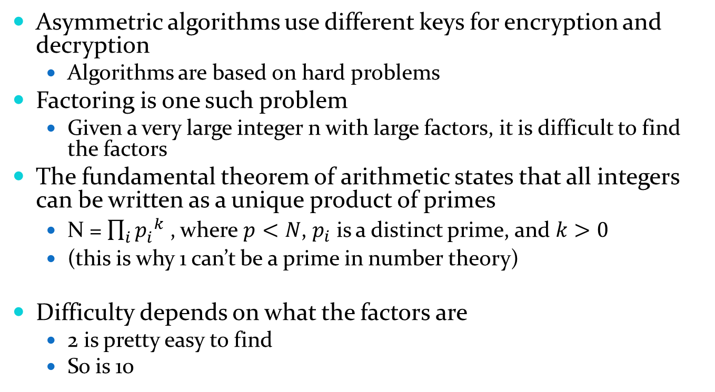
Asymmetric construction
Asymmetric algorithms use different keys for encryption and decryption
Algorithms are based on hard problems
Factoring is one such problem
Given a very large integer n with large factors, it is difficult to find the factors
The fundamental theorem of arithmetic states that all integers can be written as a unique product of primes
N = $\prod_{i}{{p_{i}^{}}_{}^{k}}$ , where $p<N$, $p_{i}$ is a distinct prime, and $k>0$
(this is why 1 can’t be a prime in number theory)
Difficulty depends on what the factors are
2 is pretty easy to find
So is 10
Notes:
Fun fact: in number theory, 1 is not a prime. What are the implications for the fundamental theorem if it were?

Slide 64
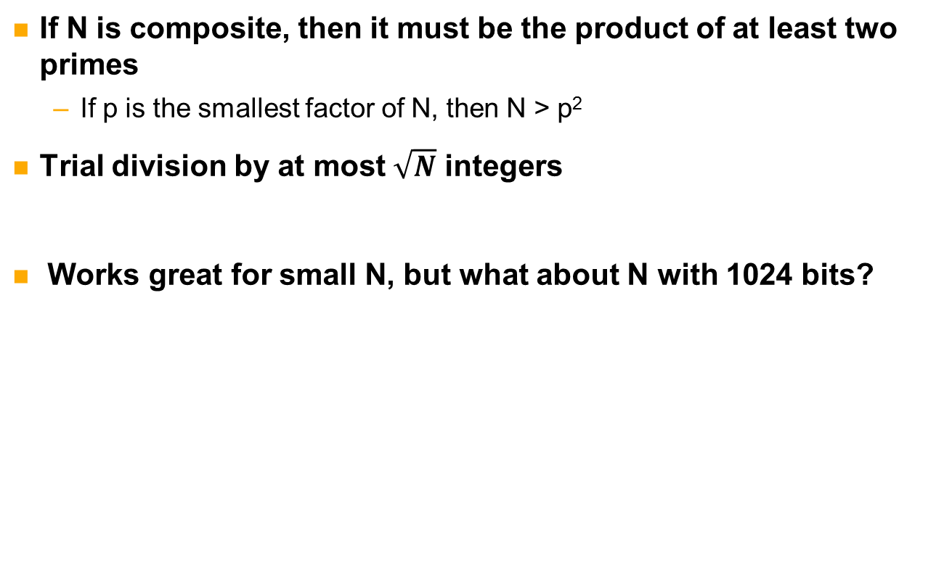
Naïve method (brute force)
If N is composite, then it must be the product of at least two primes
If p is the smallest factor of N, then N > p²
Trial division by at most $\sqrt{N}$ integers
Works great for small N, but what about N with 1024 bits?

Slide 65
Another approach
N is composite, let p be the smallest prime factor of N
If x ≠ x’ and x ≡ x’ (mod p), then p ≤ gcd(x – x’, N) < N
Can find p by finding collision
x ≡ x’ (mod N)
Why should this work?
p|N
p|(x – x’)
If x ≡ x’ (mod N), then (x – x’)|N
gcd(x – x’, N) is a factor of N
1,N, and N’s prime factors
So if 1 < gcd(x – x’, N) < N, then gcd(x – x’, N) is a prime factor of N

Slide 66
Pollard’s Rho
Algorithm for finding cycles in number patterns
Two variables moving at different speeds
A = f(A)
B = f(f(B))
Graph looks like the symbol rho
Cycle
Tail

Slide 67
Example
N = 1517
Let f(x) = (x² + 1) mod N
Start at A=134
Sequence A = f(A) is
134
1270
330
1194
841
360
656
1026
1396
989
1174
841
360
656
1026
1396
989
1174
Sequence repeats at 841

Slide 68
Example
N = 1517
Let f(x) = (x² + 1) mod N
Start at A=134
134
1270
330
1194
841
360
656
1026
1396
989
1174
841
360
656
1026
1396
989
1174

Slide 69
Example
N = 1517
Let f(x) = (x² + 1) mod N
Start at A=134
Tail length: 4
Cycle length: 7
134
1270
330
1194
841
360
1174
989
656
1396
1026

Slide 70
Pollard’s Rho
Input: composite N,
external function f(x) = (x² + a) mod N, where a is a small integer
Output: prime factor of N, or fail
A = rand(0,N-1)
B = A
g=1
while g=1 do
A = f(A)
B = f(f(B))
g = gcd(A – B, N)
if g < N
return g
else
fail
Notes:
Rand is inclusive
Question: why do we stop if g = n? Answer: the A=B and everything form this point will just be a repeat of what we already have

Slide 71
Example
Suppose f(x) = (x² + 3) mod N
Step | A | B | GCD(A-B, N)
0 | 2 | 2 | 1
1 | 7 | 52 | 1
2 | 52 | 742 | 1
3 | 1190 | 200 | 1
4 | 742 | 705 | 37
5 | 1413 | 1458 | 1
6 | 200 | 742 | 1
7 | 561 | 200 | 1
8 | 705 | 705 | 1517
9 | 969 | 1458 | 1
10 | 1458 | 742 | 1
tail
cycle

Slide 72
Exercise
Open factoring.py
You’ll see a stub for ‘pollardRho(N)’
N is the number you are trying to factor
An f(x) function has already been created for you
It takes two parameters, x and composite N
Objective
Implement Pollard’s Rho
Factor 1234567
Finished early?
Try factoring larger integers
Don’t stop when you’ve got an answer. Let it run for a while and observe the cycles
Use gcd function in the cryptoUtils module provided in the same folder.
To import:
import cryptoUtils as cu
To use:
cu.gcd(X, N)

Slide 73
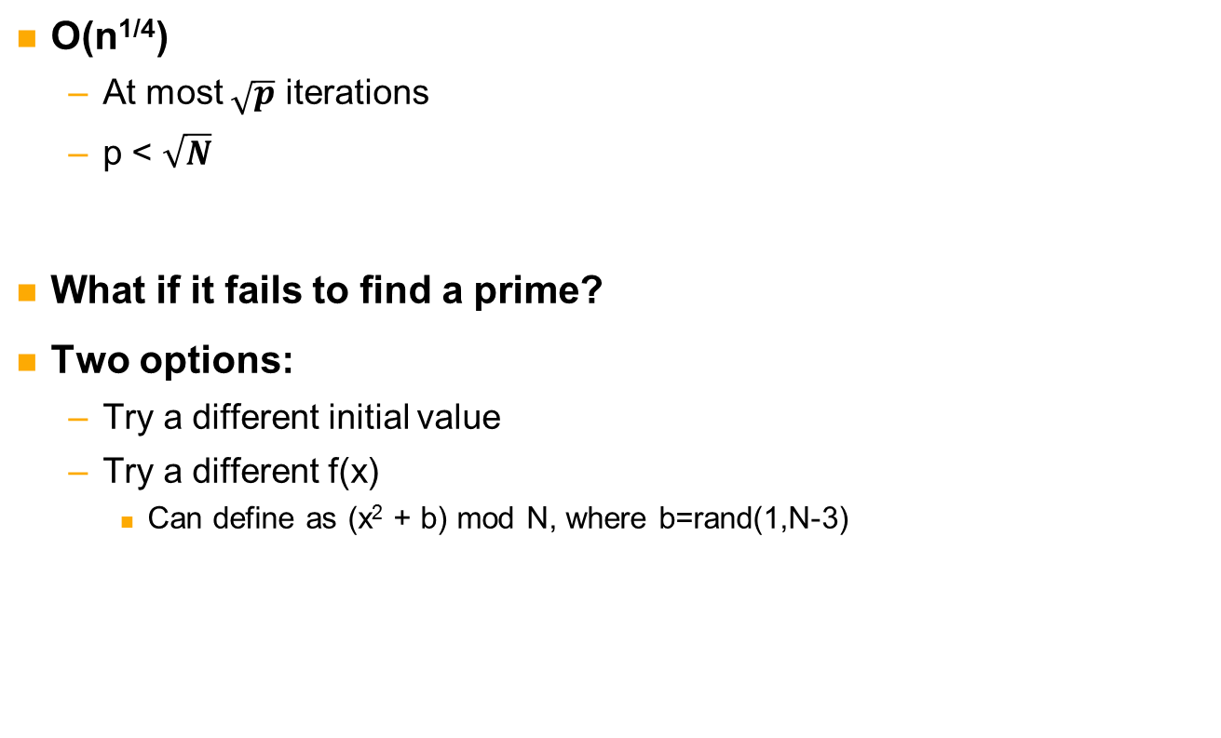
Analysis of Pollard’s rho
O(n^{1/4})
At most $\sqrt{p}$ iterations
p < $\sqrt{N}$
What if it fails to find a prime?
Two options:
Try a different initial value
Try a different f(x)
Can define as (x² + b) mod N, where b=rand(1,N-3)

Slide 74
Pollard’s p-1
Pollard has another solution to factoring
Fermat’s little theorem
Given prime p and any integer b, b^{p-1} ≡ 1 (mod p)
Let p be a prime factor of N
If x = q(p-1), then p|gcd(b^{x} – 1, N)
Let integer B be an upper bound
Going to use (p-1)|B!
May or may not work depending on values of N and B
Compute a such that a ≡ 2^{B!} (mod n) and a ≡ 2^{B!} (mod p)
a ≡ 1 (mod p)
a-1 = kp
p|(a-1)
p|n and p|gcd(a-1,n)

Slide 75
Pollard’s p-1
Input: composite N, upper bound B
Output: prime factor of N, or failure
a=2
for i=2 to B
a = a^{i} mod N
d = gcd(a-1,N)
if 1 < d < N
return d
else
fail
Note
The algorithm on page 75 of the text is
slightly different. It requires a list of primes, whereas this version does not.

Slide 76
Exercise
Open factoring.py
You’ll see a stub for ‘pollardP1(N,B)’
N is the number you are trying to factor
B is the threshold
Objective
Implement Pollard’s p-1 method
Factor 15770708441, with bound 180
Time estimate
15-30 minutes
Finished early?
Try decreasing and increasing the bound. How large does B need to be for this composite N?
What about for N=12345678910111213?
Use modExp function in the cryptoUtils module to compute a^i mod N.
To import:
import cryptoUtils as cu
To use:
cu.modExp(a, i, N)
Notes:
135978 = 2*3*131*173
B > 173

Slide 77
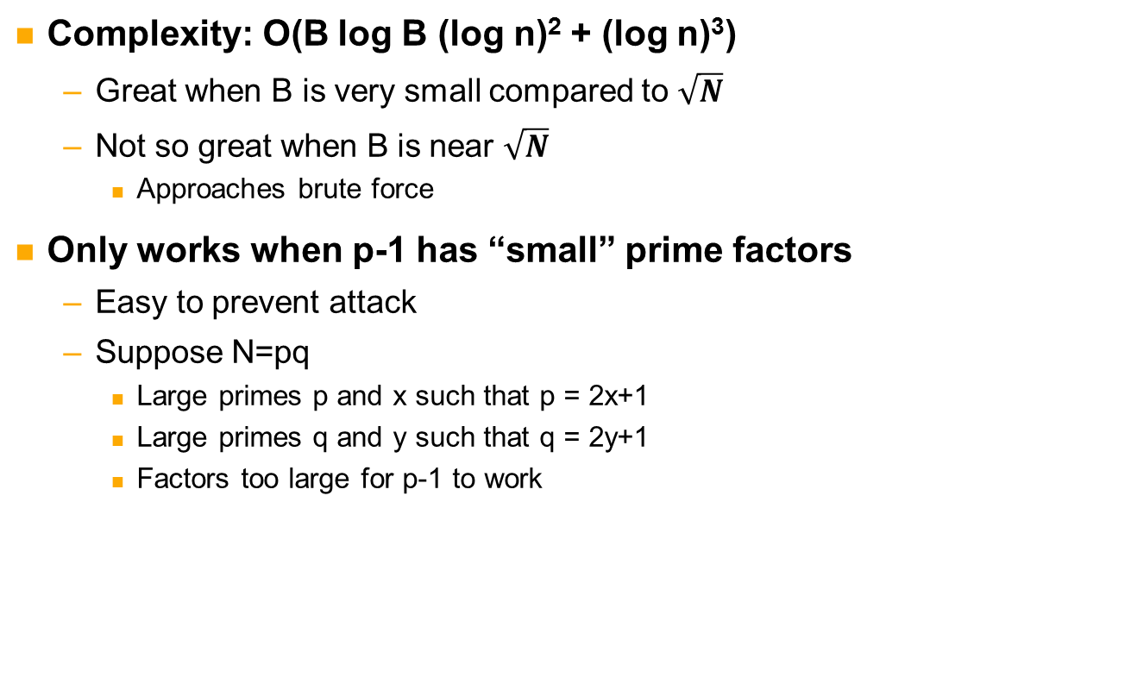
Analysis of p-1
Complexity: O(B log B (log n)² + (log n)³)
Great when B is very small compared to $\sqrt{N}$
Not so great when B is near $\sqrt{N}$
Approaches brute force
Only works when p-1 has “small” prime factors
Easy to prevent attack
Suppose N=pq
Large primes p and x such that p = 2x+1
Large primes q and y such that q = 2y+1
Factors too large for p-1 to work

Slide 78
General number field sieve
The fastest known method factoring method
Subexponential complexity
Very complicated
There’s a good reason only half a page is devoted to it in the text
Plenty of fun with polynomials, ring homomorphisms, and modular roots
There are tools available that can handle smaller numbers
GGNFS, Msieve
512 bits is doable
Might help you out in a game of capture the flag
Record: 768-bit modulus
Years of effort on distributed system
GNFS experts

Slide 79
Prime selection
Techniques we discussed can find prime factors
It is hard to find large primes
So the big question is: when the key was chosen, where did the primes come from?
Options
Have a list of large primes to use
What could go wrong?
Generate a random number of appropriate length and determine whether it is prime
But if factoring is hard, how do we know it’s a prime?
Bad idea
Good idea

Slide 80
Miller-Rabin
The standard method of finding large primes is to
Select a random number of appropriate size
Trial division of primes up to a threshold
If division succeeds, go back to 1
Use Miller-Rabin primality test to decide if it is prime
If composite, go back to 1
Miller-Rabin test finds probable primes
Monte Carlo algorithm for identifying composites
If it is not definitely a composite, then it is probably a prime

Slide 81
Miller-Rabin primality test
Input: odd integer n ≥ 3, number of trials t ≥ 1
Output: “prime” or “composite”
write n-1 = 2^{s}r, where r is odd
choose random a such that 2 ≤ a ≤ n-2
for i from 0 to t
y = a^{r} mod n
if y ≠ 1 and y ≠ n-1
j = 1
while j ≤ s-1 and y ≠ n-1
y = y² mod n
if y = 1 return “composite”
j = j+1
if y ≠ n-1 return “composite”
return “prime”
Notes:
Adapted from HAC pr 139

Slide 82
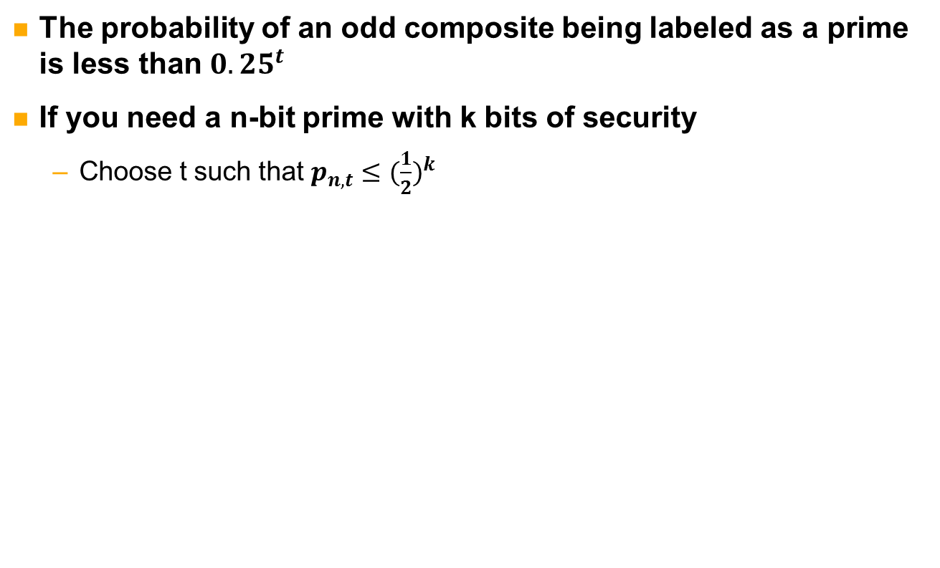
Miller-Rabin test and t
The probability of an odd composite being labeled as a prime is less than ${0.25}^{t}$
If you need a n-bit prime with k bits of security
Choose t such that $p_{n,t}≤{(\frac{1}{2})}^{k}$
Notes:
HAC

Slide 83
Exploiting prime selection
If a key distributor uses a prime list, then there’s an easy way to factor
If the list is short, just do trial divisions
Collect many moduli, {n₁, n₂, …, n_{m}}
If n_{i} and n_{j} share a prime factor, p, then gcd(n_{i}, n_{j}) = p
For each modulus, try computing a pairwise GCD until a prime is found
Even without a use of prime list, this attack will work with some probability on a large collection
The GCD computation may be costly though
Miller-Rabin relies on random number generation
If the RNG is bad (i.e. predictable), then the adversary can use that to narrow the possible inputs to the prime generation algorithm

Slide 84
Recent findings regarding primes
There have been two recent studies that looked at RSA prime selection in the wild
They both found problems
Here’s a few
Using /dev/urandom instead of /dev/random
/dev/random should be used for long-lived key generation
Blocks when entropy sources not available
Some interpreted this as a “usability issue”
Boot-time entropy hole causes prime to be generated from predictable state
Little entropy => the same primes for everyone!
IBM remote management cards that use a list of 9 primes
Wow! 9 choose 2 = 36 different moduli!
That’s right! You too can break RSA in at most 8 division operations
See:
“Mining Your Ps and Qs: Detection of Widespread Weak Keys in Network Devices”, Heninger et al.
“Ron was wrong, Whit is right”, Lenstra et al.

Slide 85
Factoring: summary
Factoring is a hard problem that is used as a foundation for asymmetric cryptosystems
The secret depends on prime factors
If the modulus can be factored, the system can be broken
There are several algorithms for factoring, but they are too computational complex to be used on large enough numbers
Prime selection is at least as important as the key length
The key length is supposed to make the primes hard to find!
Now let’s move on to specific attacks on a factoring-based cryptosystem

Slide 86
RSA
Attacking the algorithm

Slide 87
RSA (Rivest, Shamir, Adleman)
Famous factoring-based cryptosystem
Large primes p and q
N = pq
Φ(N) = (p-1)(q-1)
This function gives the number of elements 0 < x < N such that gcd(N,x)=1
Number of elements relatively prime to N
The public (encryption) exponent e that is relatively prime to Φ(N)
65537 is a popular choice
The private (decryption) exponent is computed as follows
de ≡ 1 (mod Φ(N))
This means d is the multiplicative inverse of e in Z*_{Φ(N)}
Z*_{Φ(N)} is the set {0,1,…, Φ(N)-1}

Slide 88
RSA operations
Encryption
M in Z_{N}
Z_{N} = {0,…,N-1}
C = Me mod N
Decryption
M = C^{d} mod N
Why does this work?
Euler’s theorem states that x^{Φ(N)} ≡ 1 (mod N) if N and Φ(N) are relatively prime
A corollary to Euler’s theorem allows us to show:
C^{d} mod N ≡ M^{ed} mod N ≡ M^{kΦ(N)+1} mod N ≡ M mod N
k is integer ≥ 0
In other words, M^{kΦ(N)+1} mod N ≡ (M^{Φ(N)})^{k}M mod N ≡ 1^{k}M mod N ≡ M mod N

Slide 89
RSA example
Key generation
Let p=11, q = 13, e=17
N = pq = 143
Φ(N) = (p-1)(q-1) = 10*12 = 120
d=113
17*113 = 1921 = 16*120 + 1 ≡ 1 (mod 120)
Encryption
Let m=5
5¹⁷ = 762939453125 ≡ 135 (mod 143)
Decryption
135¹¹³ ≡ 5 (mod 143)

Slide 90
RSA exercise
Open the file RSA.py
You’ll see that all of the essentials are provided
Class privKey contains private key information
Two functions, set and display
Class pubKey contains public key information
Two functions, set and display
Function genD
Creates a private exponent
Uses inverse function from cryptoUtils.py
Encrypt and decrypt functions
Use modExp function from cryptoUtils.py
To create a public key structure
Pub = pubKey()
Pub.set(p, q, e) #set the key information
Pub.display() #print the key information

Slide 91
RSA exercise
Objective
Create keys
Encrypt a message
Decrypt a message
Short list of primes
31 37 41 43 47 53 59 61 67 71 73 79 83 89 97 101 103 107 109 113
Try it with different parameters
Is a sufficient d always found?
What if e=2?
When does private exponent generation fail?

Slide 92
Attacking RSA
The private exponent can be found if N is factored
p, q, and e are all that is needed to find d
There are other attacks as well that exploit parameter properties
Public exponent e
Leaked exponents
Known Φ(N)

Slide 93
Using Φ(N)
Computing Φ(N) is as hard as factoring
Some side channel may allow its discovery
i.e. stored in memory
Can be recognized by similarity to N in most significant half
Φ(N) = (p-1)(q-1)
= pq – p – q + 1
= N – p – q + 1
Since p and q are about half the length of N, the top half of bits of Φ(N) will be very similar to those in N, especially as the length increases
Example:
Let p and q be 16 bits each, N is 32 bits
Max value (not necessarily prime) of p and q is 2¹⁶ -1
Min value (not necessarily prime) of p and q is 2¹⁵
Value of p+q is at most 2(2¹⁶ -1) = 2¹⁷ - 2 and at least 2¹⁶
N - 2¹⁷ – 1 < Φ(N) < N - 2¹⁶ + 1

Slide 94
Using Φ(N) (continued)
Φ(N) can be used to solve for p and q
Write q = N/p
Know this is an integer because q|N
Then substitute
N = pN/p = Φ(N) + p + N/p – 1
pN = p(Φ(N) + p – 1) + N
0 = p(Φ(N) + p – 1) + N – pN
= p(Φ(N) + p – 1 – N) + N
= p² – p(N – Φ(N) +1) + N
Only one unknown
Solve equation for p
This was a little tricky. We moved into the reals for division, but all of our values are integers.

Slide 95
Leaked exponent
Suppose Bob accidentally leaks his private exponent, d
Bob panics and changes his public exponent and calculates a new private exponent
His new private exponent is safe from prying eyes
Is Bob’s key secure?
Probably not
He changed the secret exponent, so why isn’t it secure?
Notes:
Las Vegas algorithm will be successful with some probability or fail with some probability, but will always give a correct answer when it does

Slide 96
Leaked exponent
There is a Las Vegas algorithm that can factor N given d
He can change d, but if he doesn’t change N we can still calculate p and q
We can derive his new private exponent
Unlike games in the real Las Vegas, the odds are very good
More than ½
Notes:
Las Vegas algorithm will be successful with some probability or fail with some probability, but will always give a correct answer when it succeeds

Slide 97
Factor with private exponent
Input: modulus N, private exponent d, public exponent e
Output: prime factor of N
Let ed-1 = 2^{s}r, r is odd
w = rand(1,N-1)
x = gcd(w,N)
If 1 < x < N
return x
v = w^{r} mod N
If v ≡ 1 (mod N)
fail
While v ≢ 1 (mod N)
v₀ = v
v = v² mod N
if v₀ ≡ -1 (mod N)
fail
Else
x = gcd(v₀ + 1,N)
return x
Stinson, “Cryptography: Theory and Practice”, 3rd Ed., page 204

Slide 98
Factor with private exponent (continued)
If it fails, try again
Different values of w yield different results
The chance the algorithm succeeds with a selected w is a little over 50%
The lesson?
If your private exponent is compromised, change your entire key
This means the primes too!

Slide 99
Exercise
Open factoring.py
You’ll see a stub for ‘VegasFactor(N, d, e)’
N is the number you are trying to factor
d is the private exponent
e is the public exponent
Objective
Implement factoring with private exponent
Factor the moduli of the following (N, d, e) tuples
(437, 317, 5)
(38419, 26269, 13)
(11021, 3139, 31)
Use modExp function in the cryptoUtils module to compute a**i mod N.
-1 ≡ N-1 (mod N)
2**x= 1<<x = 2<<(x-1)
Notes:
135978 = 2*3*131*173
B > 173

Slide 100
Low exponent attack
Suppose Alice sends a message, M, to Bob, Charley, and Dana
All of their keys have different moduli
gcd(N_{B}, N_{C}) = gcd(N_{B}, N_{D}) = gcd(N_{D}, N_{C}) = 1
All of their keys have the same small public exponent, e=3
Eve knows the following congruence relations
C_{B} ≡ M³ (mod N_{B})
C_{C} ≡ M³ (mod N_{C})
C_{D} ≡ M³ (mod N_{D})
She can efficiently find M using the Chinese Remainder Theorem

Slide 101
Chinese Remainder Theorem (CRT)
Another quick math lesson before we proceed
This will play a role in how we think about operations
Z_{N} is isomorphic to product group Z_{p} x Z_{q}
Structurally the same
Z*_{N} is isomorphic to Z*_{p} x Z*_{q}
Computing x^{b} mod N is expensive
Computing x^{b} mod p and x^{b} mod q, where N=pq is cheaper
Often used to speed up exponentiation

Slide 102
CRT example
15 = 3 * 5
Z*₁₅ = {1,2,4,7,8,11,13,14}
1 ↔ (1,1)
1 = 1 (mod 3)
1 = 1 (mod 5)
2 ↔ (2,2)
2 = 2 (mod 3)
2 = 2 (mod 5)
4 ↔ (1,4)
4 = 1 (mod 3)
4 = 4 (mod 5)
7 ↔ (1,2)
7 = 1 (mod 3)
7 = 2 (mod 5)
8 ↔ (2,3)
8 = 2 (mod 3)
8 = 3 (mod 5)
11 ↔ (2,1)
11 = 2 (mod 3)
11 = 1 (mod 5)
13 ↔ (1,3)
13 = 1 (mod 3)
13 = 3 (mod 5)
14 ↔ (2,4)
14 = 2 (mod 3)
14 = 4 (mod 5)

Slide 103
CRT example (continued)
Suppose we wanted to compute 14*13 mod 15
14 → (2,4)
13 → (1,3)
14 * 13
2*1 = 2 (mod 3)
4*3 = 2 (mod 5)
(2,2) → 2
Indeed, 14*13 = 182 ≡ 2 (mod 15)

Slide 104
Conversion back
Use extended Euclidean algorithm to find s and t
s*3 + t*5 = 1 (mod 15)
s=2, t=2
x = 3s = 6
y = 5t = 10
(1,4) → 1*y + 4*x = 1*10 + 4*6 = 34 = 4 (mod 15)
(2,2) → 2*10 + 2*6 = 32 = 2 (mod 15)
And so on

Slide 105
Low exponent attack (continued)
M³ ≡ C_{B} (mod N_{B})
M³ ≡ C_{C} (mod N_{C})
M³ ≡ C_{D} (mod N_{D})
M³ ≡ C_{B}*(N_{C}*N_{D})*((N_{C}*N_{D})⁻¹ mod N_{B}) +
C_{C}*(N_{B}*N_{D})*((N_{B}*N_{D})⁻¹ mod N_{C}) +
C_{D}*(N_{B}*N_{C})*((N_{B}*N_{C})⁻¹ mod N_{D}) mod (N_{B} * N_{C} * N_{D})
Let M’ = M³
Compute the cubic root of M’
Normal cubic root over the integers
Not the modular cubic root, which is difficult to compute

Slide 106
Low exponent attack (continued)
The number of ciphertexts needed is equivalent to the value of the public exponent
This does not mean that e=3 is necessarily insecure
The same message is essential to this attack
If only one congruence is known, this attack will not work
If e = 65537, then Alice would have to send the same message to 65537 parties with different moduli and same exponent for attack to succeed
When is the last time you sent the same message to 65537 of your closest friends using RSA?
Just another reason that this is a popular exponent choice
Small enough to facilitate fast encryption
Large enough to make small exponent attacks difficult

Slide 107
How is this useful?
Bad protocols
Good protocols use nonces to prevent messages from being predictably identical
Same message sent repeatedly
Same every time
You need to capture e ciphertext-modulus pairs
If e=3, only need 3 pairs
If e=65537, need 65537 pairs
Also need to take the 65537th root instead of cubic root
Take away
When you design protocols, add random nonces
When you select a public exponent, choose one greater than 3
Still want to keep them small for efficiency

Slide 108
Exercise
Suppose Alice sends M to three parties with the following public keys
N₁ = 11413, e₁ = 3
N₂ = 18511, e₂ = 3
N₃ = 3799, e₃ = 3
You capture the following ciphertexts
C₁ = 6249
C₂ = 6032
C₃ = 2260
Objective: find the plaintext, M
Notes:
1: p=101, q=113
2: p=107, q=173
3: p=109,

Slide 109
Exercise
Open RSA.py
Complete function lowExponent(C1,N1,C2,N2,C3,N3,e)
Verify that your solution for M is correct using the public keys
Make sure the encryption creates the correct ciphertext
Hints
x**a is python for xª
1/3 = 0, but 1.0/3 = 0.3333…
int(x) casts a float to an int, but it might give an incorrect answer
Try int(math.ceil(x))
Yay, rounding!

Slide 110
A note on RSA
We’ve only been talking about “plain” RSA
Deterministic
Same input and key always results in same output
RSA is more often used with padding
Parts of the message are random
This is a good thing!
Makes it more difficult to get two of the same or known plaintext-ciphertext pair

Slide 111
DISCRETE LOG
Asymmetric systems

Slide 112
Generators
We need a little bit more algebra for this section
Suppose ◊ = modular multiplication
The set generated by a (denoted <a>) is all elements that can be written as a⁰,a¹,a²,...
In Z*_{N}, this would be all elements that can be written as a^{i} mod N
The order of a set is the number of elements in the set
The order of <a> is the smallest positive x such that a^{x} = 1
If ◊ = addition, then x such that ax = 0
Example
Let a=2, N=7
2¹ mod 7 = 2
2² mod 7 = 4
2³ mod 7 = 8 mod 7 = 1
The set generated by 2 (in Z*₇) is <2> = {1,2,4}
<2> has order 3 in Z*₇

Slide 113
Generators (continued)
An element a generates a set S if all elements in S can be expressed as a power of a
In previous example, 2 only generates a subset of Z*₇
What about <3>?
3¹ mod 7 = 3
3² mod 7 = 2
3³ mod 7 = 6
3⁴ mod 7 = 4
3⁵ mod 7 = 5
3⁶ mod 7 = 1
The set generated by 3 (in Z*₇) is <3> = {1,2,3,4,5,6} = Z*₇
3 generates Z*₇

Slide 114
The discrete log problem
Given a, b, and p, what is the value of x if α^{x} mod p = β?
This is hard (in terms of complexity) on classical computers
i.e. your computer
There may be multiple solutions for x
Why?

Slide 115
Why are multiple solutions possible?
Let n be the order of α mod p
Then α^{n} ≡ 1 (mod p)
Can expand this
α^{2n} ≡ (α^{n})² ≡ 1² ≡ 1 (mod p)
More generally, α^{kn} ≡ (α^{n})^{k} ≡ 1^{k} ≡ 1 (mod p)
Can write x as a function of n
i.e. x = kn+j
We saw that the order of <2> mod 7 is only 3 (as opposed to 6)
Suppose 2^{x} mod 7 = 4
x = 0*3 + 2
2² mod 7 = 4 mod 7 = 4
x = 1*3 + 2 = 5
2⁵ mod 7 = 32 mod 7 = 4
And that is all that are in Z*₇, but there are an infinite number of solutions in Z
There is only one solution in Z*_{p} if α generates Z*_{p}

Slide 116
How do you find a generator of a set?
Two options
Randomized algorithm
Choose a standard modulus and generator
The algorithm
Choose random element α in Z*_{p}
For all i, where p_{i} is a factor of (p-1)
Compute b = α^{((p-1)/p}i⁾,
If b = 1, go back to step 1
Return α
Diffie-Hellman key exchange is a discrete log crypto algorithm
Used in SSH and IKE
Standardized groups ☺
There’s several
Parties agree on modulus size and group before exchange
Let’s take a look at some, shall we?

Slide 117
Diffie-Hellman group 1
RFC 2409
Different modulus sizes specified
768-bit, 1024-bit
Elliptic curve groups as well, but we haven’t done those yet
Not the most secure option these days
Example: 768-bit modulus
Generator is 2
768-bit prime is (in hex)
FFFFFFFF FFFFFFFF C90FDAA2 2168C234 C4C6628B 80DC1CD1 29024E08 8A67CC74 020BBEA6 3B139B22 514A0879 8E3404DD EF9519B3 CD3A431B 302B0A6D F25F1437 4FE1356D 6D51C245 E485B576 625E7EC6 F44C42E9 A63A3620 FFFFFFFF FFFFFFFF

Slide 118
Diffie-Hellman group 14
RFC 3526
Different modulus sizes specified
1536-bit, 2048-bit, 3072-bit, 4096-bit, 6144-bit, and 8192-bit
Example: 1536-bit modulus
Generator is 2
1536-bit prime is (in hex)
FFFFFFFF FFFFFFFF C90FDAA2 2168C234 C4C6628B 80DC1CD1 29024E08 8A67CC74 020BBEA6 3B139B22 514A0879 8E3404DD EF9519B3 CD3A431B 302B0A6D F25F1437 4FE1356D 6D51C245 E485B576 625E7EC6 F44C42E9 A637ED6B 0BFF5CB6 F406B7ED EE386BFB 5A899FA5 AE9F2411 7C4B1FE6 49286651 ECE45B3D C2007CB8 A163BF05 98DA4836 1C55D39A 69163FA8 FD24CF5F 83655D23 DCA3AD96 1C62F356 208552BB 9ED52907 7096966D 670C354E 4ABC9804 F1746C08 CA237327 FFFFFFFF FFFFFFFF

Slide 119
Standardized generators
These examples both have 2 has the generator
This is not a coincidence
2 has good properties
Exponentiation is expensive
Multiplication is expensive
Left shifts are cheap
2^{x} can be written as 1<<x
Efficient!
But as we saw with p=7, 2 won’t generate every group
2⁰ = 1 = 1 << 0
2¹ = 2 = 1 << 1
2² = 4 = 1 << 2
2³ = 8 = 1 << 3
And so on

Slide 120
Baby-step giant-step method
Use lookup tables to save time
Tradeoff with space
Precompute first L powers of α

Slide 121
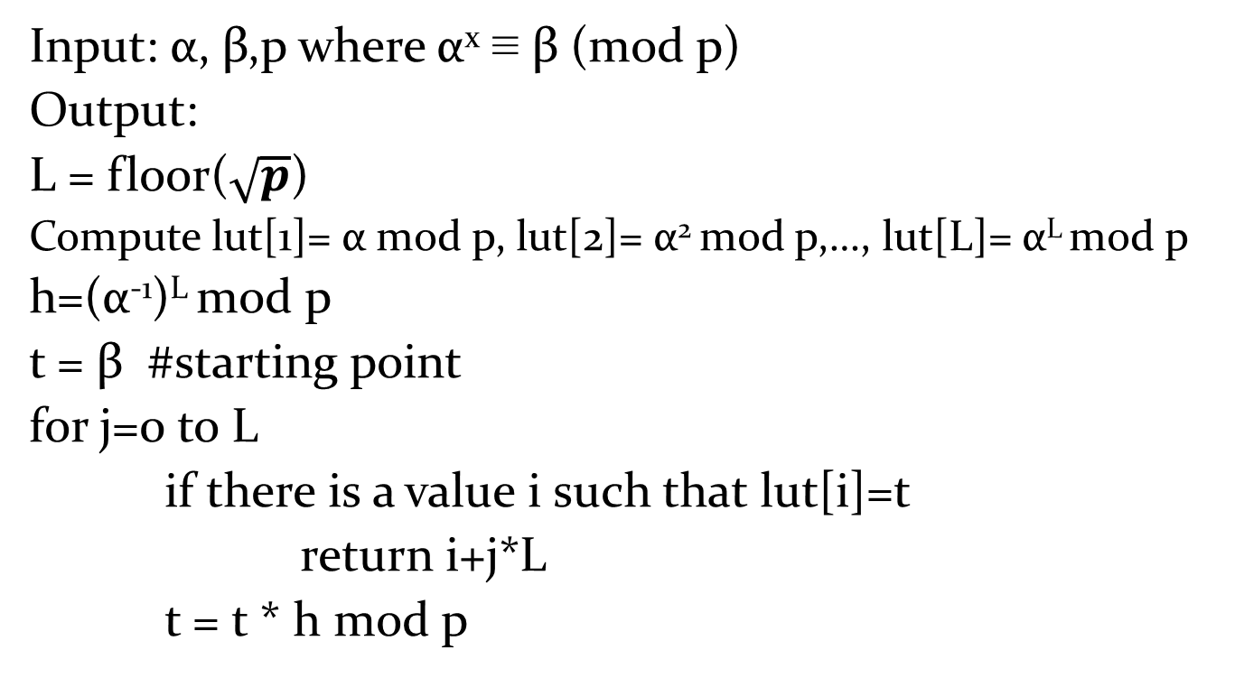
Baby-step giant-step algorithm
Input: α, β,p where α^{x} ≡ β (mod p)
Output:
L = floor($\sqrt{p}$)
Compute lut[1]= α mod p, lut[2]= α² mod p,…, lut[L]= α^{L} mod p
h=(α⁻¹)^{L} mod p
t = β #starting point
for j=0 to L
if there is a value i such that lut[i]=t
return i+j*L
t = t * h mod p

Slide 122
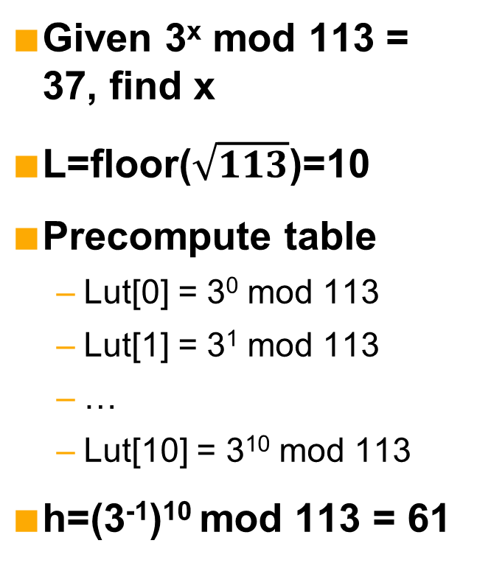
BSGS Example
Given 3^{x} mod 113 = 37, find x
L=floor($\sqrt{113}$)=10
Precompute table
Lut[0] = 3⁰ mod 113
Lut[1] = 3¹ mod 113
…
Lut[10] = 3¹⁰ mod 113
h=(3⁻¹)¹⁰ mod 113 = 61
Iterate through j loop
j: 0, t: 37
j: 1, t: 110
j: 2, t: 43
j: 3, t: 24
j: 4, t: 108
j: 5, t: 34
j: 6, t: 40
Result: 10*6 + 7 = 67
3⁷ mod 113 = t = 40
j = 6
40 is at index 7, which is why it is added to 10*6
t = β
If value not
found, set next t:
t = t * h mod p

Slide 123
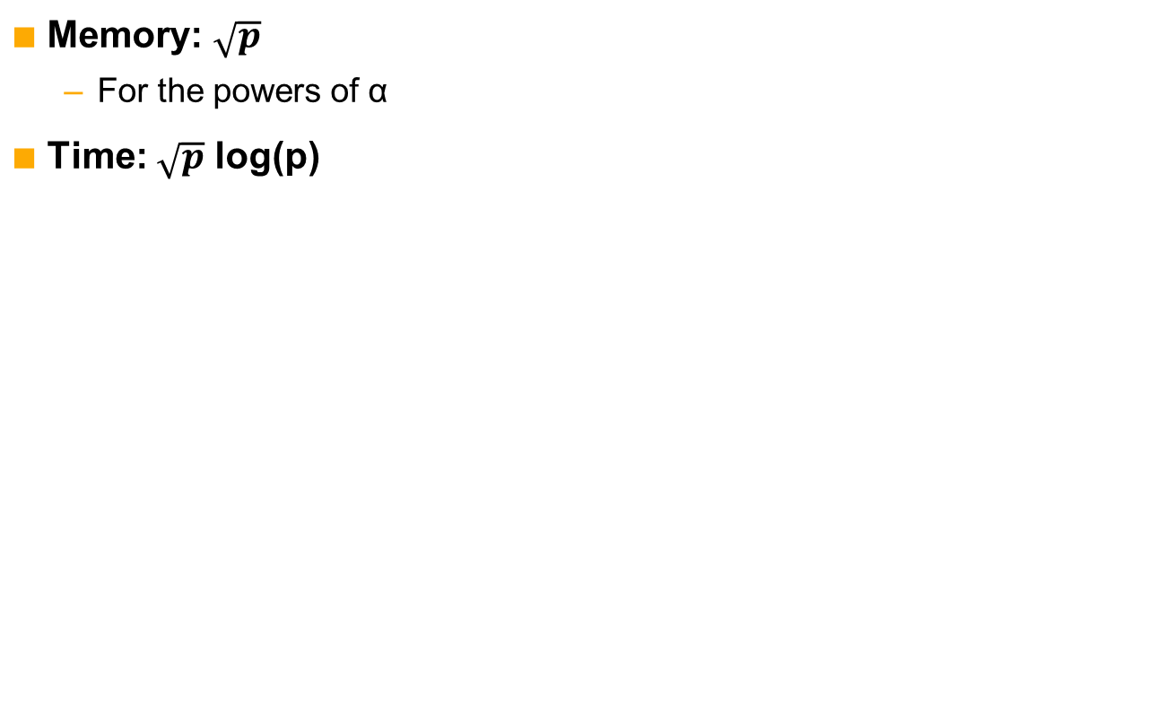
BSGS analysis
Memory: $\sqrt{p}$
For the powers of α
Time: $\sqrt{p}$ log(p)

Slide 124
Exercise
Open discreteLog.py
Complete babyStepGiantStep(a,b,p)
a is generator, b is result, p is prime modulus
Objective: try to solve and verify the following
89^{x} mod 809 = 618
16^{x} mod 809 = 46
16^{x} mod 809 = 324
2^{x} mod 2777 = 512

Slide 125
Adaptations
Factoring ↔ discrete log
Algorithms can be adapted
Pollard’s rho
Partition {0, …, p-1} into three sets of approximately equal size
Many partitions possible
{0,…, (p-1)/3}, {(p-1)/3+1,…, 2(p-1)/3}, {2(p-1)/3,…,p-1}
x ≡ 0 (mod 3), x ≡ 1 (mod 3), x ≡ 2 (mod 3)
Compare triples (x_{i}, a_{i}, b_{i}) and (x_{2i} , a_{2i} , b_{2i})
Look for collision x_{2i} = x_{i}
Notes:
Scripts won’t look nice in ppt. On board, write x_2i = α^{a_2i}β^{b_2i}, x_i = α^{a_i}β^{b_i}, therefore a collision occurs when α^{a_2i}β^{b_2i} = α^{a_i}β^{b_i}

Slide 126
Pollard’s rho for discrete logs (Swenson)
Input: α,β,p
Output: solution to α^{x} mod p = β
a₀ = b₀ = 0
x₀ = 1
i = 0
While x_{i} ≠ x_{2i} do
i = i+1
x_{i} = f(x_{i-1})
a_{i} = g(x_{i-1}, a_{i-1})
b_{i} = h(x_{i-1}, b_{i-1})
x_{2i} = f(f(x_{2i-2}))
a_{2i} = g(f(x_{2i-2}), g(x_{2i-2}, a_{2i-2}))
b_{2i} = h(f(x_{2i-2}), h(x_{2i-2} , b_{2i-2}))
If b_{i} = b_{2i}
fail
m = a_{i} - a_{2i} mod (p-1)
n = b_{2i} - b_{i} mod (p-1)
Solve mx ≡ n (mod p-1) for x
If x in partition 1
f(x) = βx mod p
g(x,n) = (n+1) mod (p-1)
h(x,n) = n mod (p-1)
If x in partition 2
f(x) = x² mod p
g(x,n) = 2n mod (p-1)
h(x,n) = 2n mod (p-1)
If x in partition 3
f(x) = αx mod p
g(x,n) = n mod (p-1)
h(x,n) = (n+1) mod (p-1)

Slide 127
Solving for x
mx mod (p-1) = n
x = n/m mod (p-1)
Oh division, how you trip us up
The inverse of multiplication is multiplication
x = m⁻¹n mod (p-1)
Use inverse(m,p-1) in cryptoUtils

Slide 128
Caveats and fine print
This version is not the most general
Assumes that α has order p-1
May not be the case
While α^{p-1} ≡ 1 mod p, there may be an x < p-1 such that α^{x} ≡ 1 mod p
We can say this for the version of BSGS we looked at as well, but it doesn’t matter as much there
Produces multiple solutions
Let’s look at another version from Stinson’s book
Less memory!
Generalized!
Assumes you know the order of α

Slide 129
Pollard’s rho for discrete logs (Stinson)
Input: α,β,p,n
Output: solution to α^{x} mod p = β, where α has order n
(x,a,b) = f(1,0,0)
(x’,a’,b’) = f(x,a,b)
While x ≠ x’ do
(x,a,b) = f(x,a,b)
(x’,a’,b’) = f(x’,a’,b’)
(x’,a’,b’) = f(x’,a’,b’)
If gcd(b’-b, n) ≠ 1
fail
Else
return ((a – a’)(b’ – b)⁻¹ mod n)
f:
x in partition | x | a | b
1 | βx mod p | a mod n | (b+1) mod n
2 | x² mod p | 2a mod n | 2b mod n
3 | αx mod p | (a+1) mod n | b mod n

Slide 130
Exercise
Open discreteLog.py
Complete findOrder(a, n), pollardRho(alpha,beta,p,n), and f(x,a,b,alpha,beta,p,n)
Follow Stinson’s version
Objective: try to solve and verify the following
89^{x} mod 809 = 618
16^{x} mod 809 = 46
16^{x} mod 809 = 324
2^{x} mod 2777 = 512
This exercise is from Stinson, page 239

Slide 131
Exercise hints
Use remainder mod 3 for partitions
1: x ≡ 1 (mod 3)
2: x ≡ 0 (mod 3)
3: x ≡ 2 (mod 3)
You can set three variables at once
[x,a,b] = f(x,a,b,alpha,beta,p,n)
Just need to have f return a list
return [result1, result2, result3]
If you don’t like this, you can break it into three functions like in Swenson’s algorithm

Slide 132
Index calculus
Does not involve derivatives or integrals
We’re saving that for later ☺
Most powerful discrete log attack
Analog to GNFS
Not really described in the text
Not in Stinson either
If you want to read more, see the HAC
Here we go!

Slide 133
Index calculus algorithm
Choose a factor base (set of primes)
Obtain set of congruence relations mod p
Represent with factor base
Create system of equations (mod order of α)
Solve the system
Profit

Slide 134
Example
From HAC, page 110
Problem: 6^{x} ≡ 13 (mod 229)
6 has order 228
Factor base = {2,3,5,7,11}
To obtain congruence relations, raise 6 to power mod 229
If result can be represented as a product of factor base, keep the relation
Otherwise, discard it

Slide 135
Example (continued)
Relations:
6¹⁰⁰ mod 229 = 180 = 2²*3²*5
6¹⁸ mod 229 = 176 = 2⁴*11
6¹² mod 229 = 165 = 3*5*11
6⁶² mod 229 = 154 = 2*7*11
6¹⁴³ mod 229 = 198 = 2*3²*11
6²⁰⁶ mod 229 = 210 = 2*3*5*7
Relations give the following log equations
100 ≡ 2 log₆ 2 + 2 log₆ 3 + log₆ 5 (mod 228)
18 ≡ 4 log₆ 2 + log₆ 11 (mod 228)
12 ≡ log₆ 3 + log₆ 5 + log₆ 11 (mod 228)
62 ≡ log₆ 2 + log₆ 7 + log₆ 11 (mod 228)
143 ≡ log₆ 2 + 2 log₆ 3 + log₆ 11 (mod 228)
206 ≡ log₆ 2 + log₆ 3 + log₆ 5 + log₆ 7 (mod 228)
Note that we’re using p-1 here

Slide 136
Example (continued)
Equations (from previous slide)
100 ≡ 2 log₆ 2 + 2 log₆ 3 + log₆ 5 (mod 228)
18 ≡ 4 log₆ 2 + log₆ 11 (mod 228)
12 ≡ log₆ 3 + log₆ 5 + log₆ 11 (mod 228)
62 ≡ log₆ 2 + log₆ 7 + log₆ 11 (mod 228)
143 ≡ log₆ 2 + 2 log₆ 3 + log₆ 11 (mod 228)
206 ≡ log₆ 2 + log₆ 3 + log₆ 5 + log₆ 7 (mod 228)
Rewrite in a more familiar style
2a + 2b + c = 100
4a + e = 18
b + c + e = 12
a+ d + e = 62
a + 2b + e = 143
a + b + c + d = 206
Key:
a = log₆ 2
b = log₆ 3
c = log₆ 5
d = log₆ 7
e = log₆ 11
6 equations and 5 unknowns? If there is a unique solution, we can solve that!

Slide 137
Solving the system of equations
Many options
Take a trip down memory lane to high school algebra
Use Gaussian elimination, if you know it
Use tools such as Matlab, Mathematica, or Wolfram Alpha
Least license-free effort: use Wolfram Alpha
Let’s take a look at how to do this

Slide 138
Solving the system with Wolfram Alpha
Go to www.wolframalpha.com
Enter the following in the equation line
integer solutions ((2a+2b+c) mod 228) = 100, ((4a+x) mod 228) = 18, ((b+c+x) mod 228) =12, ((a+d+x) mod 228) = 62, ((a+2b+x) mod 228) = 143
Workarounds
Notice that we took out ((a+b+c+d) mod 228) = 206
Not sure why, but it did not work with all six equations
“e” is interpretted as the transcendental number e, so we replace it with some other character, like “x”
Because we took one equation out, we couldn’t find a unique solution
Calculate again, replacing one of the equations with the one we took out

Slide 139
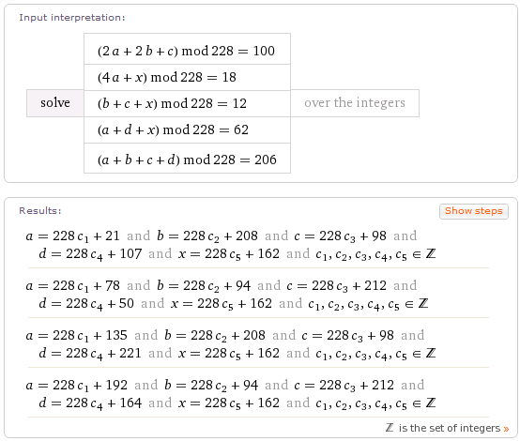
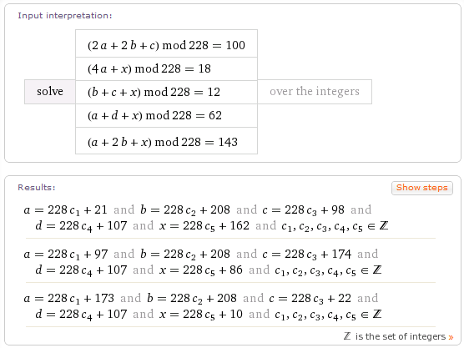
Solving the system with Wolfram Alpha (continued)
Both solution sets contain one match
a=21, b=208, c=98, d=107, x=162
This is the solution
log₆ 2 = 21, log₆ 3 = 208, log₆ 5 = 98, log₆ 7 = 107, and log₆ 11 = 162

Slide 140
We have a solution. Now what?
Recall we started with 6^{x} ≡ 13 (mod 229)
Pick a random k between 0 and N-1, inclusive
Calculate β*α^{k} = 13 * 6^{k} and represent with logs we just found
Example:
Suppose k=77
13 * 6⁷⁷ mod 229 = 147
147 = 3 * 7²
log₆ 13 = (log₆ 3 + 2 log₆ 7 – 77) mod 228 = 117
So x = 117
6¹¹⁷ ≡ 13 (mod 229)

Slide 141
Exercise
Suppose p = 10007, and α = 5
Let {2,3,5,7} be the factor base
Objective: find log₅ 9451 (mod 10007)
Hints
log₅ 5 is an easy congruence
Factoring will be trial and error, but the factor base is so small that it will be easy
Adapted from Stinson example 6.5

Slide 142
Discrete log: summary
Solve for x if α^{x} mod p = β
Factoring techniques may be adapted
Pollard’s rho
Baby-Step Giant-Step
Index calculus

Slide 143
Implementation notes for factoring and discrete log
We’ve done small examples with python here
If you ever want to do this with realistic size moduli, you’ll need something that allows larger integers
BIGNUM data structures
Only limited by available memory
Luckily, there are handy libraries you can use
OpenSSL BIGNUM library
http://www.openssl.org/docs/crypto/bn.html
GNU MP
http://gmplib.org/

Slide 144
Symmetric Systems
An introduction

Slide 145
Symmetric cryptosystems
Saw that asymmetric algorithms based on hard problems
Solving the problem finds the key
Symmetric systems are based on principles of confusion and diffusion
Confusion: obscures the relationship between plaintext and ciphertext
Diffusion: spreads plaintext statistics through the ciphertext
A bit of the output is influenced by many bits of the input
Both forward and backward diffusion are important!
Finding the key is… different
Niels Ferguson once told me that cryptanalysis was half mathematics and half black magic
Everyone here likes magic, right?
Let’s learn some tricks
Notes:
Niels also says that real security is a teddy bear. I think my “security blanket” from Shmoocon 2013 is pretty spiffy too.

Slide 146
Little bit of math, little bit of magic
First, we’ll look at a couple kinds of constructions
Not an exhaustive list, but you’re likely to see these in practice
Then we’ll move onto the math and “magic” we need to analyze them
The math
Probability
A dash of statistics
Linear algebra
The magic
Slide attacks
Linear cryptanalysis
Differential cryptanalysis
Integral cryptanalysis

Slide 147
Common Construction
plaintext
Round 1
Product cipher
Combines two or more transformations
Resulting cipher more secure than components
Simple function f
Algorithm = f ○ f ○ f ○ f ○ f ○ … ○ f ○ f
○ is composition
f(f(f(f(f(….f(f(x))) … )))))
f is called a round function
Round 2
Round n-1
Round n
ciphertext

Slide 148
Round function
Provides confusion and diffusion
Key combined with state (confusion)
Often called “key mixing”
Non-linear transform
Often implemented as a substitution
S-box
Data mixing/permutations (diffusion)
Each bit of output depends on many bits of input
In the best case, all
One round doesn’t have to achieve high confusion and diffusion
High confusion and diffusion achieved by repeated application of round function
There may be multiple unique round functions

Slide 149
Round function (continued)
Composition of simple function has benefits over single complicated function
Several optimization options available
Pick the best implementation strategy for the target
32-bit architecture
8-bit architecture
Limited memory
Loop unrolling
Smaller circuit size
We’ll talk about two round function constructions
Substitution permutation network
Feistel

Slide 150
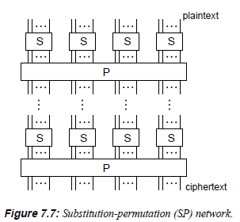
Substitution permutation network
Substitution layer comprised of S-boxes
Takes in a small number of bits (i.e. a byte)
Outputs a small number of bits
Relation between input and output is complex
High-degree polynomial
Not linear
Permutation layer
May also be called a P-box
Shuffles all the bits of the state
May do so in chunks
Image is from the HAC

Slide 151
A closer look at permutations
Let’s look at three different permutations
Suppose each “chunk” is the input/output of an S-box on previous slide
Which provides most diffusion? The least?
Draw it out to see
x | 0 | 1 | 2 | 3
P(x) | 1 | 0 | 3 | 2
x | 0 | 1 | 2 | 3
P(x) | 1 | 2 | 0 | 3
x | 0 | 1 | 2 | 3
P(x) | 1 | 2 | 3 | 0
Notes:
Draw path of first table, then have them do the others on their own

Slide 152
A closer look at permutations (continued)
Ok, that was a trick
They were all equally terrible
Since the same groupings just go from S-box to S-box, all of them have a simple form
To provide diffusion, the permutation has to mix data between S-boxes
A cipher with a permutation layer like this is just begging to be attacked
More on this later

Slide 153
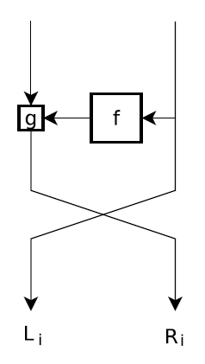
Feistel
Main features
State is split in two parts
Non-linear transform performed on one part
Result combined with other part
Parts swap
Encryption and decryption use the same round function logic
Less code
Fewer gates
Each part is usually half
Called a balanced Feistel function

Slide 154
Key schedule
We’ve talked about types of round functions, but need one more piece
Key isn’t usually applied as-is each round
It goes through a function to produce a key schedule
Set of keys
Can be generated as needed, or before first round is applied, depending on algorithm
Each round uses one of these keys
When decrypting, they are applied in reverse order from encryption
True in Feistel ciphers as well

Slide 155
EASY1
Toy cipher in the textbook
Diagram on page 101
Features
SPN construction
36-bit blocks
18-bit key
Creates 36-bit key where upper and lower 18-bits are identical
Most of the Python code is on pages 103-106
Missing from this section: apbox and asbox (part of decryption)
They show up in later pages
EASY1.py has all the code you need to run EASY1
Object-oriented version of what is in the book

Slide 156
EASY1.py
To use:
Create an EASY1 object
cipher = EASY1 ()
Encrypt
Arguments are plaintext, key, and number of rounds
C = cipher.encrypt(123L, 456, 1)
Decrypt
Arguments are ciphertext, key, and number of rounds
Mp = cipher.decrypt(C, 456, 1)
Mp should give you 123 back
In this implementation, you can give encrypt/decrypt either an 18-bit key or 36-bit key
Will create 36-bit key from 18-bit
Checks form of 36-bit key
Alright – let’s try it!

Slide 157
Exercise
Objective: use the EASY1 cipher in EASY1.py
Open a new file and write a script that does the following
Encrypts the message 123456 with key 9876
Decrypts the message
Reports an error if the decrypted message does not match the original

Slide 158
Ready?
Now that we’ve got that down, let’s get down to some analysis!
☺

Slide 159
Generic attacks
For symmetric systems

Slide 160
The extremes
Assume Eve discovers a plaintext-ciphertext pair
Two extreme methods for finding the key
Brute force
Exhaustive key search
Try each possible key on single plaintext/ciphertext
Message not known ahead of time
Takes O(1) memory and O(2^{k}) operations, where the key has k bits
Massive pre-computation
Pre-compute all possible ciphertexts for P
Takes O(2^{k}) memory
After pair observed, perform a lookup
Assuming lookup is constant, takes O(1) operations

Slide 161
Hellman’s time-memory trade-off
Also called time-space trade-off
Memory is what is meant by space
Middle ground between brute force and massive pre-computation
Main idea: create chains of encryptions, and only store the start and end of each chain
This is best described visually

Slide 162
TMTO
If C has more bits than the key, then a reduction has to be performed before the next encryption
Choose a starting point, S
Choose a plaintext, P
C = E(P,S)
The result becomes the key for the next encryption in the chain
Repeat until endpoint, EP, reached
Go back to step 1
P
P
P
P
P
P
S
E
E
E
E
….
E
E
EP
P
P
P
P
P
P
S₂
E
E
E
E
….
E
E
EP₂
P
P
P
P
P
P
S₃
E
E
E
E
….
E
E
EP₃

Slide 163
TMTO (continued)
The attacker stores each (S, EP) pair
May do this for several different plaintexts, but need to keep track of which chains associated with which P
Let’s say there are t pairs
Now we move from the pre-computation to the attack
Obtain a plaintext-ciphertext pair, where the plaintext is P
Compute an encryption chain starting with the ciphertext
Keep track of the number of encryptions performed, i
When an endpoint is reached, know which chain you’re on
Calculate forward from the starting point until C_{t-i-1} reached

Slide 164
Convergence, cycles, etc.
Chains do not always run in parallel
Sometimes they converge
Multiple starting points terminate in the same endpoint
Sometimes they form cycles
In both cases, work is performed that does not provide any new information
Waste of time
Workaround: add some randomness
Choose a permutation function, F, for each chain
Calculate C_{i} = F(E(P, C_{i-1}))

Slide 165
The effect of F
Without F functions
From here, the second chain duplicates the first
With F functions
Because F is different in each chain, they diverge again

Slide 166
F and reality
Using a different F for each chain brings up a problem
Have to now store each of these functions
Alternative: choose r different functions
For each function, construct m chains
Each chain should start at a random point
This produces r tables with m chains of length t

Slide 167
FindChains algorithm
for i=0 to r-1
choose random function F_{i}
for j=0 to m-1
SP_{ij} = rand(2^{k})
C₀ = SP_{ij}
for L = 1 to t-1
C_{L} = F_{i}(E(P, C_{L-1}))
EP_{ij} = C_{t-1}
These algorithms adapted from “Applied Cryptanalysis” by Stamp and Low

Slide 168
findEP algorithm
Input: C and (SP,EP) pairs
Output: corresponding EP or failure
findEP(C)
for i=0 to r-1
Y=F_{i}(C)
for j=1 to t
for L=0 to m-1
if Y == EP_{iL}
found = findKey(i,j,L)
if found
return found
Y=F_{i}(E(P,Y))
return failure

Slide 169
findKey
Inputs: i (table number) ,L (chain number), j (position in chain), ciphertext C
Output: key or failure
findKey(i,L,j)
Y = SP_{iL}
for q=1 to t-j-1
Y=F_{i}(E(P,Y))
K=Y
if C == E(P,K)
return K
else fail

Slide 170
How many chains?
That depends on how certain you want to be that you’ll get the result
Longer chains and more chains will cover more of the key space
More chains means more memory
Longer chains means more computation in both pre-computation and attack phases
Hellman suggested the following for a k-bit key
2^{k/3} tables
2^{k/3} chains
2^{k/3} iterations per chain
Probability of success = 1 – e^{–mtr/2k}
With above, this is 0.63
Assumes not cyclical and not converging
Bad chains reduce success probability

Slide 171
Exercise
Implement TMTO on EASY1
Open TMTO.py
Finish the following functions
F
findChains
findKey
findEP
Objectives
Analyze the chains of EASY1
Derive the chains, but also print out some of the intermediate points
This will help you debug your code!
Use TMTO to find the key

Slide 172
Exercise: tips and tricks
You can create a “random” function like this
Fi = "(({0}*3+{1}*{2}) % 2**25 ) & 0x3FFFFL".format(x,i,r)
res = eval(Fi)
This is an example, feel free to use your own!
You may want to try some things to ensure your code is functioning properly
Some suggestions:
Make sure the key is inside a chain by fixing SP[i][j] to the key
Tests when the key is an SP
Print out where in a chain it is
Tests when the key is inside a chain
i.e. not an SP

Slide 173
Myth: more rounds equals more secure
Fact: adding more rounds can increase security, but it is not inherently given
Let’s see why

Slide 174
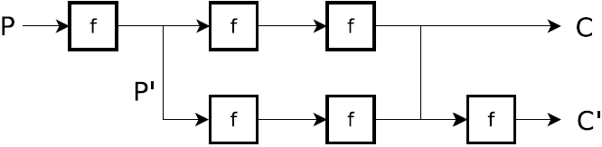
Slide attacks
Suppose all round functions are completely identical
All have same round key as well (key schedule is just repeated applications of the key)
Then m round functions can be reduced to one in analysis
Need to find slid pairs
Plaintexts P and P’ that produce ciphertexts C and C’ (respectively) such that P’ = f(P) and C’ = f(C)

Slide 175
Slide attacks (continued)
The trick here is realizing when you have a slid pair
May be difficult with an SPN
Feistel constructions are simpler
Suppose right side is transformed during round
Then left side is unchanged, and swapped with the right
Old left side is new right side
Aren’t there false positives?
Of course
The probability that this happens in both the (P,P’) pair and (C,C’) pair is low
Much higher if you are only considering one

Slide 176
I get it now!
The purpose of the key schedule is to ensure that each round is not 100% identical
The round transformation might be the same, but applying a different key will yield different results
The round key should be unique for each round
If there are two round keys alternate, then the slide attack can be done by looking at two rounds instead of one
It is the repetition that causes vulnerability

Slide 177
Exercise (part 1)
All rounds of EASY1 are identical
Let’s try a slide!
We’ll do this in two parts
Open slide.py
Assume you’re in a chosen plaintext model
Complete Slide.CreateSlidPair()
Objectives
Identify how to determine when you have found a slid pair
Write code that finds the key, given a slid pair
Tips
You can request a single round encryption using self.key as key argument
The key will change each time you run the code, so look at what is always the same

Slide 178
Exercise (part 2)
Let’s change models
Now assume that you are collecting plaintext-ciphertext pairs, but cannot make requests
i.e. you have to generate both plaintexts randomly
Complete Slide.findSlidPair()
Now you need to recognize a pair instead of creating one
Generate random plaintext and compute ciphertext
Objective
Reduce a 20-round cipher to one round and find the key
This means no more 1-round requests with the key – 20 rounds only!
Tips
You can still make one round requests with a fixed key of your choosing, just not the randomly selected one

Slide 179
More math
Just a little

Slide 180
Product groups
We’ve talked about groups
If they commute, they are abelian groups
A product group is constructed from several groups
Suppose (G,+) is an abelian group
G^{n} = G x G x … x G
Recall when we did this with CRT
Example:
Consider G = {0,1}
G² = G x G (two bits)
Each element of is a G² 2d vector
(0,0), (0,1), (1,0), (1,1)
u + v = w means u_{i} + v_{i} = w_{i}
(1,0) + (0,1) = (1,1)
Exclusive-or, in this case

Slide 181
Linearization
Attacks often reason in a linearized version of a cipher
An n-bit integer → Z₂^{n}
Working with vectors of bits

Slide 182
Probability
A
B
C
p₁
1
1
p₄
1
p₂
2
2
p₅
2
p₃
p₆
3
3
3
Random variables take on values according to a probability distribution
Probability that a letter in English is “e”
Probability that a letter in English is “z”
If X is the random variable, write Pr(X=e) and Pr(X=z)
In image above, what is Pr(C=2) if we know that A=1?
Pr(B=1|A=1) = p₁, Pr(B=2|A=1) = p₂, Pr(B=3|A=1) = p₃
Pr(C=2|B=1) = p₄, Pr(C=2|B=2) = p₅, Pr(C=2|B=3) = p₆
Pr(C=2|A=1) = Pr(C=2|B=1) Pr(B=1|A=1) + Pr(C=2|B=2) Pr(B=2|A=1) +
Pr(C=2|B=3) Pr(B=3|A=1) = p₁p₄ + p₂p₅ + p₃p₆

Slide 183
Statistics
The only distribution we care about right now is the uniform distribution
Distribution of a perfect cipher
Histograms are the only tool we need
No Z-tables or t-tables for us!
We will only be concerned with
Values that occur far from expected in a uniform distribution
Values that occur an expected number of times

Slide 184
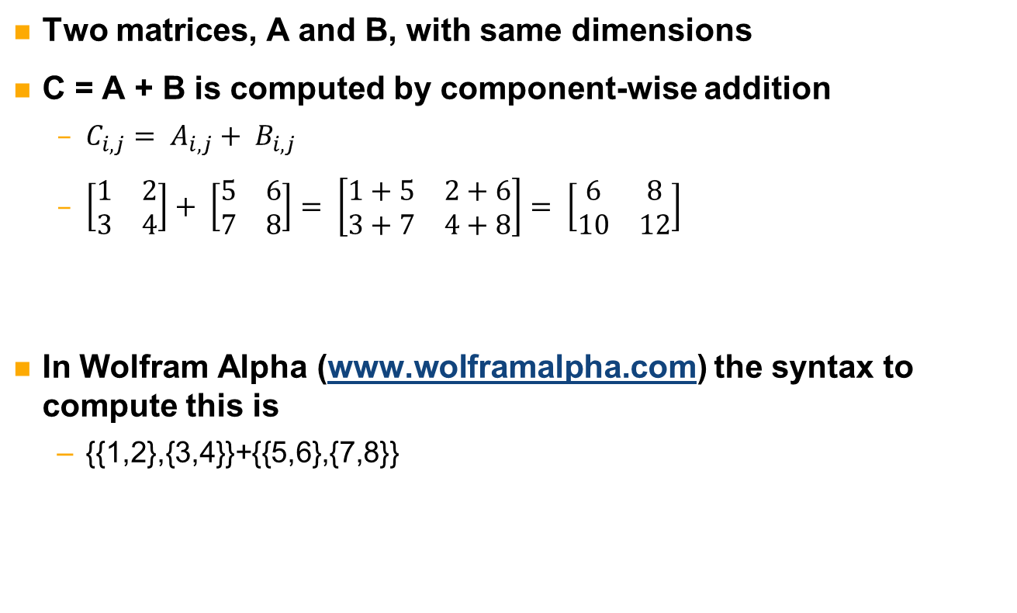
Matrix addition
Two matrices, A and B, with same dimensions
C = A + B is computed by component-wise addition
$C_{i,j}= A_{i,j}+ B_{i,j}$
$\left[\begin{matrix}1 & 2 \\ 3 & 4\end{matrix}\right]+ \left[\begin{matrix}5 & 6 \\ 7 & 8\end{matrix}\right]= \left[\begin{matrix}1+5 & 2+6 \\ 3+7 & 4+8\end{matrix}\right]= \left[\begin{matrix}6 & 8 \\ 10 & 12\end{matrix}\right]$
In Wolfram Alpha (www.wolframalpha.com) the syntax to compute this is
{{1,2},{3,4}}+{{5,6},{7,8}}

Slide 185
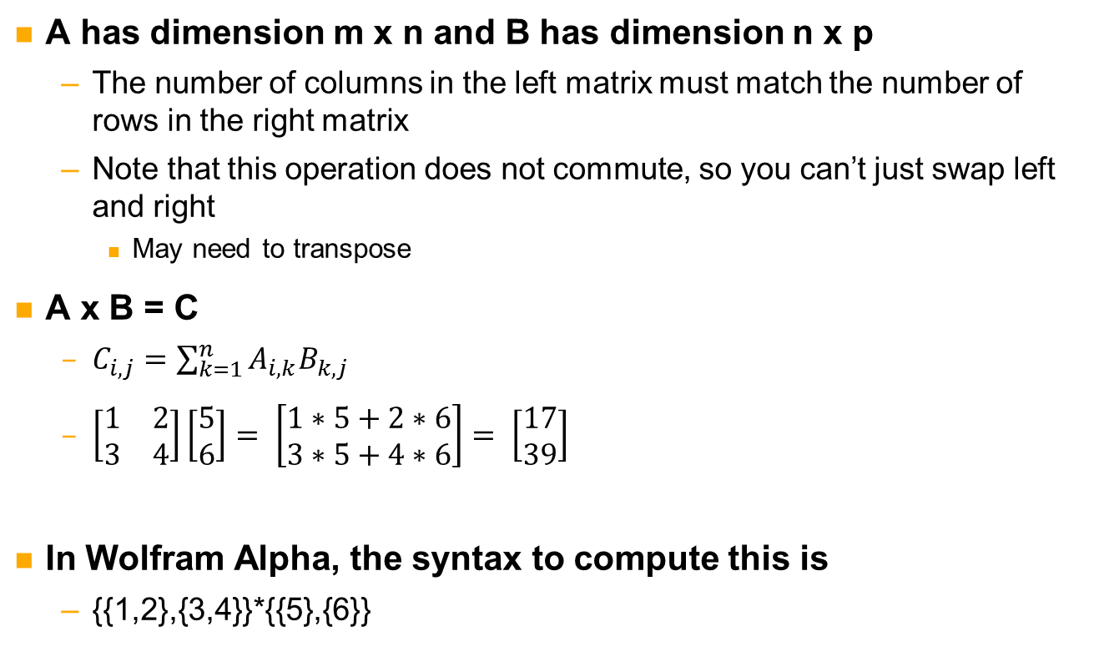
Matrix multiplication
A has dimension m x n and B has dimension n x p
The number of columns in the left matrix must match the number of rows in the right matrix
Note that this operation does not commute, so you can’t just swap left and right
May need to transpose
A x B = C
$C_{i,j}=\sum_{k=1}^{n}{A_{i,k}B_{k,j}}$
$\left[\begin{matrix}1 & 2 \\ 3 & 4\end{matrix}\right]\left[\begin{matrix}5 \\ 6\end{matrix}\right]= \left[\begin{matrix}1∗5+2∗6 \\ 3∗5+4∗6\end{matrix}\right]= \left[\begin{matrix}17 \\ 39\end{matrix}\right]$
In Wolfram Alpha, the syntax to compute this is
{{1,2},{3,4}}*{{5},{6}}

Slide 186
Caveats
It is pretty straightforward with regular addition and multiplication
Remember that in our abstract algebra world, + and x might mean something else
+ might be exclusive-or or modular addition
x might be a different kind of multiplication
In AES, it is multiplication in a Galois Field
Polynomial fun

Slide 187
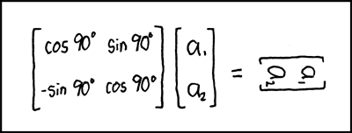
Some xkcd math humor
http://xkcd.com/184/

Slide 188
Linear & differential cryptanalysis
Symmetric systems

Slide 189
Attacking symmetric systems
Find a simple way to express a relationship between input bits and output bits
Use math-fu to find key data
Profit

Slide 190
Partitioning is the key concept
When you’re targeting a particular algorithm, you can do more than in generic attacks
A significant difference between asymmetric and symmetric systems is the ability to partition the state and still retain information
Reduce your work
Isolate parts of the state/key as much as possible
If the part you’re interested doesn’t use a set of key bits, then they can be ignored
2^{n/3} + 2^{n/3} + 2^{n/3} is a lot smaller than 2^{n}
Example: n=9
8+8+8 = 24 vs. 512
This is why diffusion is important
Prevents adversary from isolating sections

Slide 191
Linear cryptanalysis
Working with vectors of bits
1011 → (1,0,1,1)
Operation is exclusive-or
Suppose cipher has n-bit input and output, m-bit key
Write the plaintext as P = (p₀, …, p_{i}, …, p_{n-1})
Write ciphertext as C = (c₀, …, c_{i}, …, c_{n-1})
Write key as K = (k₀, …, k_{i}, …, k_{m-1})
Main idea: approximate part of a non-linear function using a linear expression
p₀ ⊕ p₂₀ ⊕ c₉ ⊕ c₂₄ ⊕ c₁ ⊕ k₀ ⊕ k₁ ⊕ k₇ = 0
Tells us the parity of 3 bits of key
p₀ ⊕ p₂₀ ⊕ c₉ ⊕ c₂₄ ⊕ c₁ = k₀ ⊕ k₁ ⊕ k₇
Note that if 1 appears in the equation, it is affine
Won’t work here
Notes:
Parity is the sum of all bits in a number

Slide 192
How do you approximate a function?
Start with the non-linear elements
Linear elements are easy to write as linear expressions
No approximation needed
In an SPN, this will be the S-boxes
Try to approximate the output in terms of the input
Let’s consider the following 3-bit S-box
3-bits in
3-bits out
S-box
input | 0 | 1 | 2 | 3 | 4 | 5 | 6 | 7
output | 3 | 7 | 2 | 4 | 1 | 5 | 0 | 6

Slide 193
Linear S-box approximation
input | 0 | 1 | 2 | 3 | 4 | 5 | 6 | 7
output | 3 | 7 | 2 | 4 | 1 | 5 | 0 | 6
First, note that there are 2³ * 2³ = 2³⁺³ = 2⁶ = 64 different expressions
You can see how this grows with larger S-boxes
Use a mask to determine if a bit is part of the expression
A mask of 101 means that the most significant and least significant bits are part of the expression
Input: 101, output 110 translates to x₀ ⊕ x₂ = y₁ ⊕ y₂
Equivalently, x₀ ⊕ x₂ ⊕ y₁ ⊕ y₂ = 0
Need to try all possible input output pairs
2⁶ * 2³ = 512 operations
Count how many times the equation is true

Slide 194
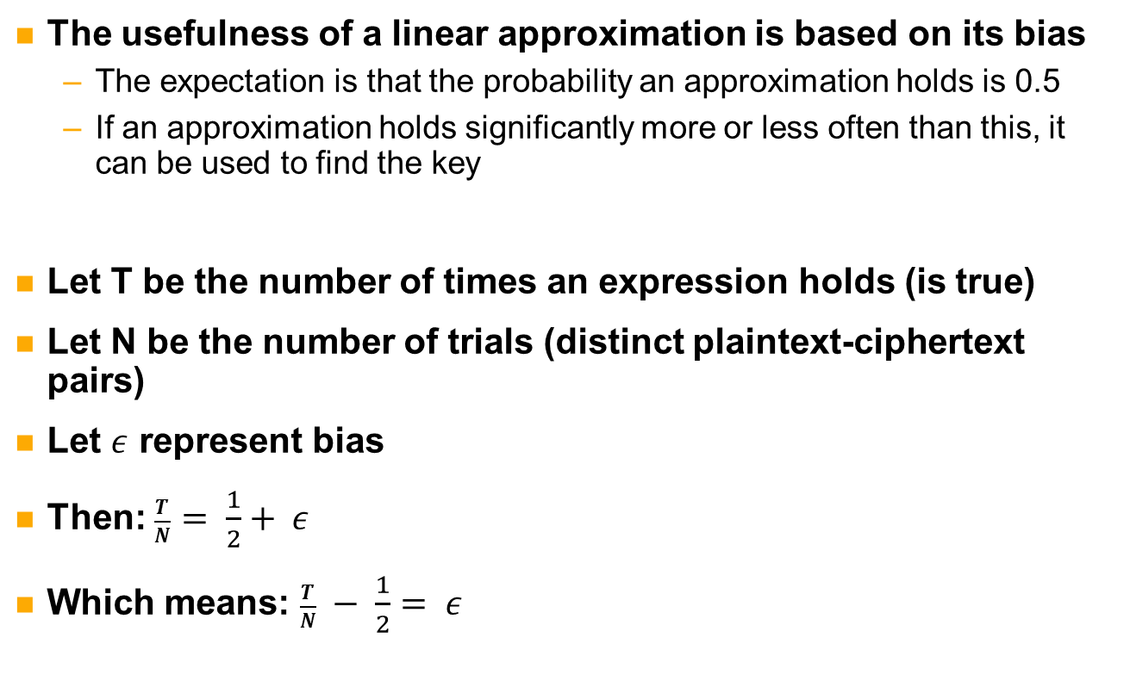
Linear expression bias
The usefulness of a linear approximation is based on its bias
The expectation is that the probability an approximation holds is 0.5
If an approximation holds significantly more or less often than this, it can be used to find the key
Let T be the number of times an expression holds (is true)
Let N be the number of trials (distinct plaintext-ciphertext pairs)
Let $ε$ represent bias
Then: $\frac{T}{N}= \frac{1}{2}+ ε$
Which means: $\frac{T}{N} − \frac{1}{2}= ε$

Slide 195
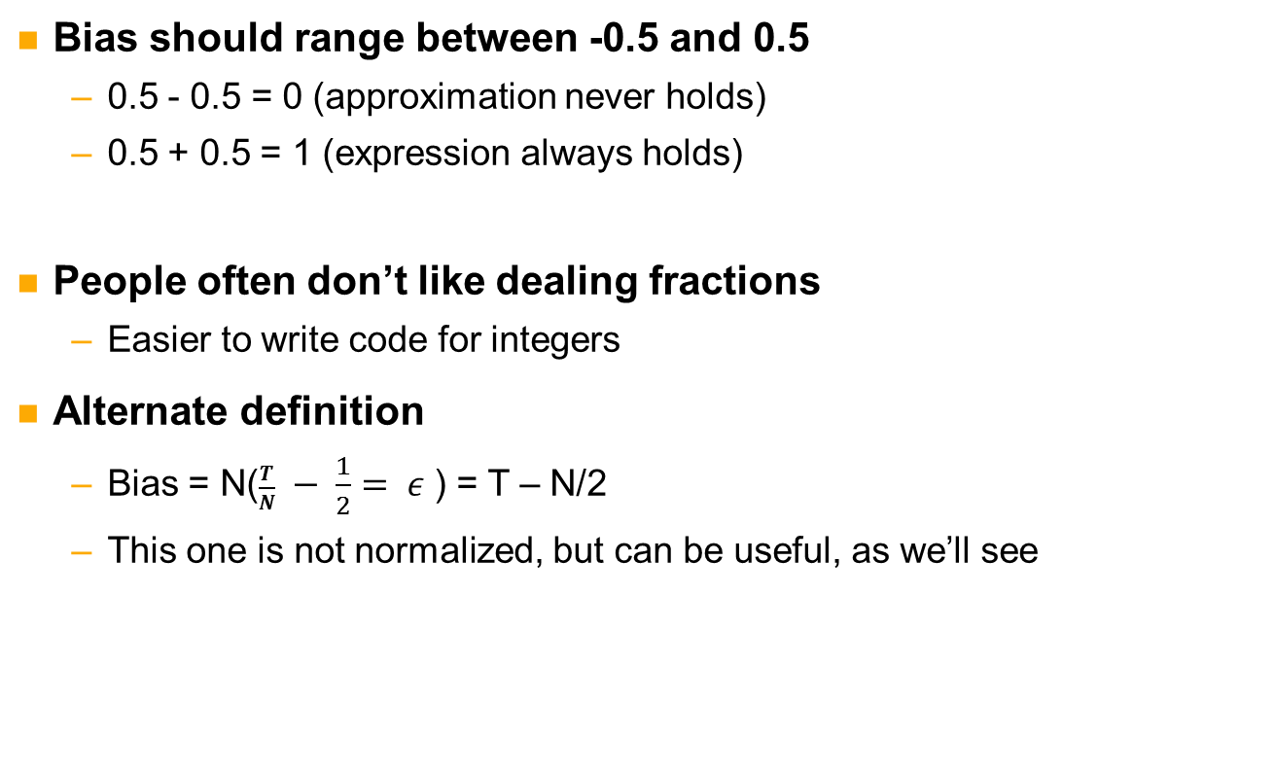
Two notations for bias
Bias should range between -0.5 and 0.5
0.5 - 0.5 = 0 (approximation never holds)
0.5 + 0.5 = 1 (expression always holds)
People often don’t like dealing fractions
Easier to write code for integers
Alternate definition
Bias = N($\frac{T}{N} − \frac{1}{2}= ε$ ) = T – N/2
This one is not normalized, but can be useful, as we’ll see

Slide 196
Linear round approximation
Once the non-linear components are approximated, the rest is usually much simpler
Trace the bits of your approximations through the rest of the round
Input and output masks for the round
Once you have input and output masks for one round, extend to another
And so on, as far as you can go with a reasonable bias

Slide 197
What really happens
Don’t usually use ciphertext bits in approximation
If you’re looking to break R rounds, you need an expression for R-1 rounds
The “ciphertext” of the approximation is the output of round R-1
The ciphertext is the output of R rounds
From the ciphertext, backup to the output of round R-1
This requires guessing some bits of the last round key
These guesses are going to be where you get your power
Otherwise, you’d just get 0 or 1

Slide 198
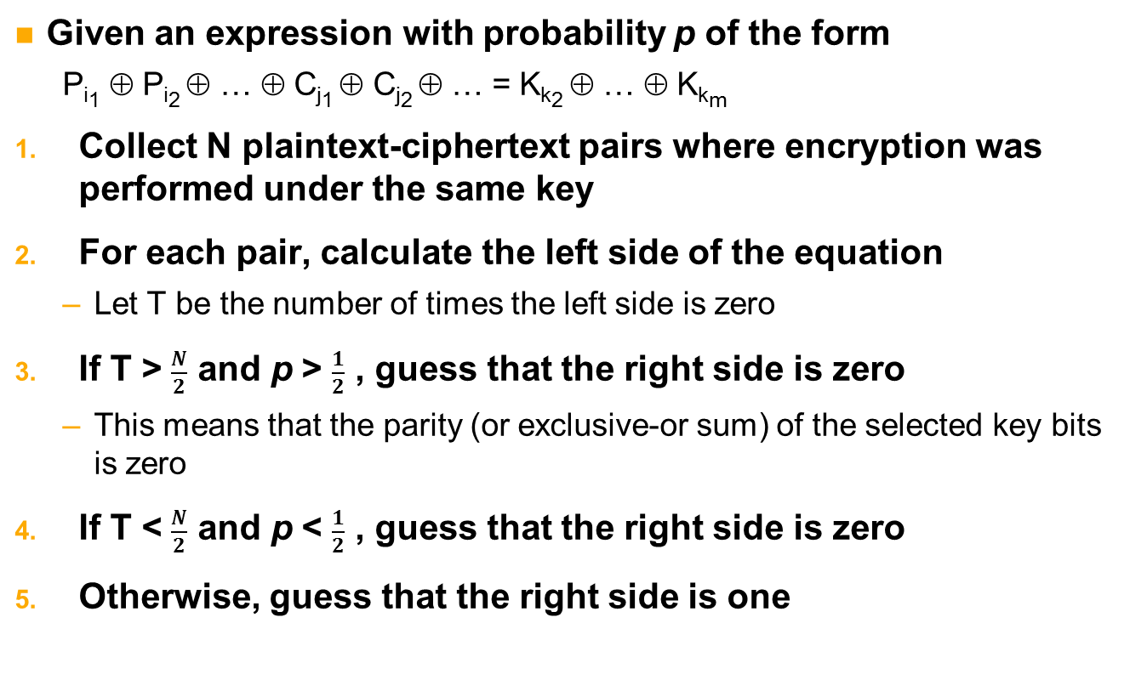
Matsui’s algorithm 1
Given an expression with probability p of the form
P_{i1} ⊕ P_{i2} ⊕ … ⊕ C_{j1} ⊕ C_{j2} ⊕ … = K_{k2} ⊕ … ⊕ K_{km}
Collect N plaintext-ciphertext pairs where encryption was performed under the same key
For each pair, calculate the left side of the equation
Let T be the number of times the left side is zero
If T > $\frac{N}{2}$ and p > $\frac{1}{2}$ , guess that the right side is zero
This means that the parity (or exclusive-or sum) of the selected key bits is zero
If T < $\frac{N}{2}$ and p < $\frac{1}{2}$ , guess that the right side is zero
Otherwise, guess that the right side is one

Slide 199
Matsui’s algorithm 1 (continued)
Pros
Low implementation cost
Nothing but xor operations
Cons
Must know probability, p
This algorithm gives only the parity
He gave a second, more useful algorithm

Slide 200
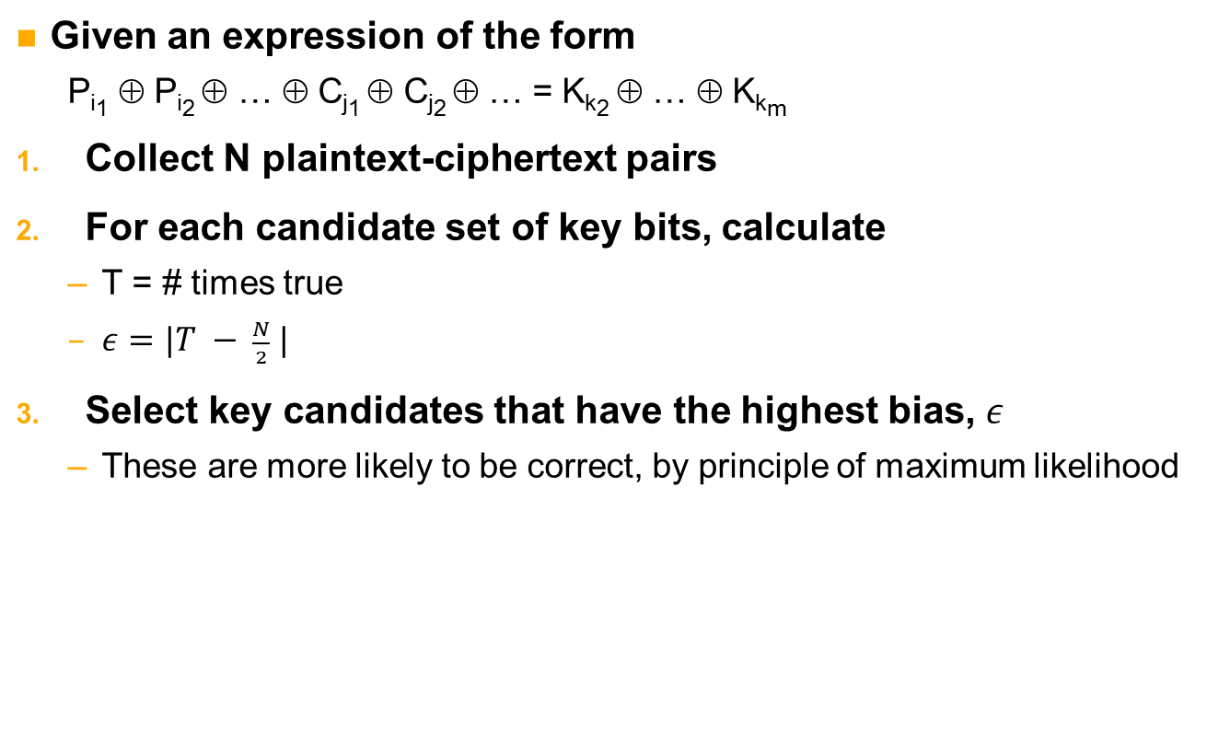
Matsui’s algorithm 2
Given an expression of the form
P_{i1} ⊕ P_{i2} ⊕ … ⊕ C_{j1} ⊕ C_{j2} ⊕ … = K_{k2} ⊕ … ⊕ K_{km}
Collect N plaintext-ciphertext pairs
For each candidate set of key bits, calculate
T = # times true
$ε=|T − \frac{N}{2} |$
Select key candidates that have the highest bias, $ε$
These are more likely to be correct, by principle of maximum likelihood

Slide 201
Matsui’s algorithm 2 (continued)
Pros
Gives [partial] key candidate rankings in addition to parity
Don’t need to know the probability
Cons
Requires N calls to the cipher for each candidate key
Comparison
1 takes less work, but yields less information
You’ll have to make up the work later if you want to find the key
It is assumed that the attacker knows everything but the key, so access to the encryption function is assumed
Key bits with the same parity may not be equally good. Algorithm 2 will rank these, but algorithm 1 will not

Slide 202
What does bias look like?
2-dimensional table
Row: input mask
Column: output mask
Bias and masks often written in hex
(0,0) is always equal to N/2, so ignore it
Involves not input or output bits
More for completeness than anything else
Example
A 2-bit S-box may have the following table
 | 0 | 1 | 2 | 3
0 | 2 | 0 | 0 | 0
1 | 0 | -1 | 1 | 1
2 | 0 | 1 | 0 | 0
3 | 0 | 0 | 1 | -1
Notes:
What are the expressions?
N=4, Max bias = 2, Min bias = -2
X_1 = y_1

Slide 203
Exercise in three parts
We’re going to try linear cryptanalysis on two rounds of the EASY1 cipher
Break this down into three parts
Find biases of linear expressions for the s-box
Extend approximation to two full rounds
Use expressions to find key bits

Slide 204
Exercise: part 1
In this part, we only care about the S-box
We’re going to use the bias notation T-N/2, since it is easier to code
Objectives:
Calculate S-box bias for all possible expressions
Fill in function findBias
Create a frequency table for each bias, and display
Fill in function findFrequency
Identify high-bias expressions
At least the top 4
Use findMasks
Hints
Setting a bit to zero has the same effect as not including it in the expression, so use AND operations to zero out any unneeded bits
You can use decimal or hex, just be consistent
Don’t look at next slide yet

Slide 205
Exercise: part 1 discussion
The highest bias is 16
Remember, the bias in cell (0,0) doesn’t count!
14, 12, and -12 are next highest
12 and -12 are equally strong
Frequency isn’t actually part of the attack
Observe how rare high-bias expressions are compared to low-bias
What matters is strong biases involving a small number of bits

Slide 206
Exercise: part 2
Look at table 6-4 of the text (page 177)
You see some expressions have smaller bias, but also fewer addends
Choose 2 of these expressions to try in this part
Objectives:
Extend these expressions to find input/output masks for one full round
Extend one round to two rounds
Hints
When extending to one round, follow bits of S-box output mask forward
When going from one round to two, follow the first round input bits back (find dependencies)
This is a pen & paper exercise
You can use the image in the book to trace the paths
It may take you a couple tries and different S-box approximations for each round
Don’t worry about the key yet – we’ll get there
Notes:
Table 6-4 (page 177) has the S-box linear expressions with the highest bias

Slide 207
Exercise: part 2 (more hints)
There are really three masks here
Input to two rounds
Output of two rounds
Between rounds
A lot of bits in the middle may mean more in the input or output
Set the middle to either the left or right half of each equation
Look carefully equations and how they trace in both directions
Minimizing bits in key bits used will save time in key recovery step
You don’t need to find the minimum, but try your best
Mind the permutations!
Bit x of the output in one S-box in not necessarily bit x of input to the next
This may take a while, so don’t get discouraged if it takes a few tries
Input mask
Round 1
Intermediate
Round 2
Output mask

Slide 208
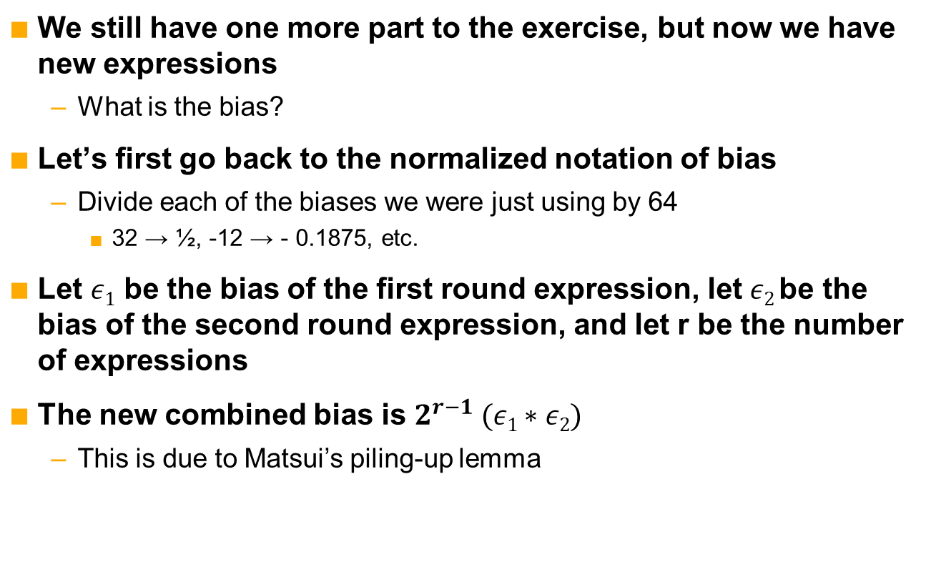
Sidebar: what is the bias now?
We still have one more part to the exercise, but now we have new expressions
What is the bias?
Let’s first go back to the normalized notation of bias
Divide each of the biases we were just using by 64
32 → ½, -12 → - 0.1875, etc.
Let $ε1$ be the bias of the first round expression, let $ε2$be the bias of the second round expression, and let r be the number of expressions
The new combined bias is $2^{r−1} (ε1∗ε2)$
This is due to Matsui’s piling-up lemma

Slide 209
Exercise: part 3
Now it is time to find those key bits!
Use the two-round approximation from part 2 to perform a 3-round attack
Backup from ciphertext to third round input using guessed key bits
You only need to guess the key bits that are in the expression and required to backup
Objectives
Fill in attack()
Create equations in format for Matsui’s algorithm 2
Implement algorithm 2
Find bias for each candidate, and sort
Which key bits are most likely?

Slide 210
Exercise: part 3 (continued)
Hints
If you need an expression, try using the S-box expressions on page 179
Use grab(x, y) to select bit y from state x
If you get stuck, complete code starts on page 189
Please try to do as much as you can on your own

Slide 211
Differential cryptanalysis
Linear cryptanalysis deals with approximating values
Differential cryptanalysis deals with differences
It doesn’t matter what the values are, as long as the correct difference is present
Now need pairs of plaintexts and pairs of ciphertexts
Instead of looking at (p,c), looking at (p,p’) and (c,c’)
Requires a stronger adversary
Need input, output, and ability to request encryption/decryption operations
Chosen plaintext attack (if encryption access)
Chosen ciphertext attack (if decryption access)
If a protocol is really poor, adversary may be able to perform attack without requests
Shouldn’t happen

Slide 212
Differences
Suppose we’re using an encryption oracle
This means that we ask something for the encryption of a message, and it gives us the result
We don’t know the key, the oracle does
Have two plaintexts, p and p’, such that p ⊕ p’ = Δ_{p}
Δ_{p} is input difference
Encrypt plaintexts under unknown key by asking oracle
c = encrypt(p)
c’ = encrypt(p’)
Calculate output difference
Δ_{c} = c ⊕ c’

Slide 213
Differences (continued)
A particular input difference leads to particular output difference with some probability
Written Pr[Δ_{p} → Δ_{c}]
Δ_{p} → Δ_{c} is called a characteristic
The probability of a characteristic is determined through analysis
Unlike linear approximations, these differences are exact
The key that produces the expected output difference with closest to the expected probability wins
Like linear cryptanalysis, we begin with the non-linear components

Slide 214
S-box characteristics
Try all possible input difference and output difference pairs
Count how many times each pair occurs
The probability of the pair (characteristic) is the count divided by the number of combinations
For EASY1, divide by 64
Influence of the key needs to be addressed
In EASY1, key addition step is
(X ⊕ K) ⊕ (X’ ⊕ K) = X ⊕ X’ ⊕ K ⊕ K = X ⊕ X’
Key does not change analysis
Not necessarily true in all ciphers!
It depends how the key is mixed in

Slide 215
Extending difference characteristics
Chain characteristics together
Particularly easy if input difference equals output difference
If you want to add a round and have output difference x, choose a high probability with input characteristic x
As in linear cryptanalysis, we want a differential that does not go to all R rounds
We want to make key guesses and backup, then check difference
Probabilities multiply
Probability of a → b → c is Pr[a → b]*Pr[b → c]
If there are multiple ways to get to c from a, chain the probabilities like we did before
Food for thought
Higher probability characteristics require fewer requests for attack to work well
Need high overall probability for multiple rounds
A high probability followed by a low one may be worse than two weaker ones
0.9*0.1 = 0.09
0.5*0.5 = 0.25

Slide 216
Exercise (part 1)
Open differential.py
Complete genMatrix()
Objectives:
Find probability for all possible characteristics over S-box
Identify high-probability characteristics
At least the top 2
More if you’re up to it

Slide 217
Exercise (part 2)
Implement the attack we described
createPairs()
differentialAnalysis(…)
Tips
Try duplicating the example in the book
Key 0x555555555
Random number generator is already seeded for you

Slide 218
Summary of linear and differential cryptanalysis
Linear
Collect plaintext-ciphertext pairs
Approximate cipher using linear equations
Differential
Make encryption/decryption requests
Calculate difference probabilities

Slide 219
Integral cryptanalysis
Symmetric systems

Slide 220
Integral
We’ve looked at linear equations
We wouldn’t want calculus to feel left out, now would we?
Relax, you don’t need to remember how to find the integral of a continuous function
We’re all about discrete math here

Slide 221
AES
We will look at this attack in terms of 4-round AES-128
The full cipher is 10 rounds
Anatomy of the Advanced Encryption Standard
Round consists of nonlinear step and linear mixing
Round structure has 4 parts
SubBytes
S-box
ShiftRows, MixColumns
Linear mixing
AddRoundKey
Combine key with state via exclusive-or
16-byte state is represented as a 2d array
4 by 4 bytes
For full spec, AES-192, and
AES-256, see FIPS 197

Slide 222
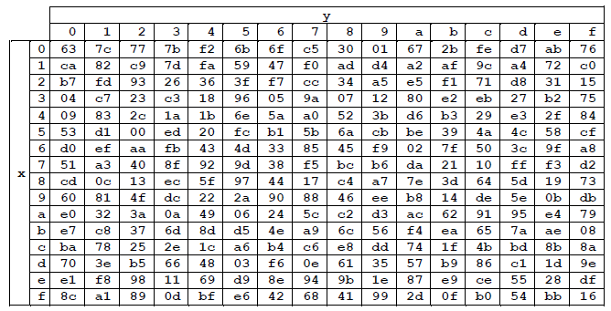
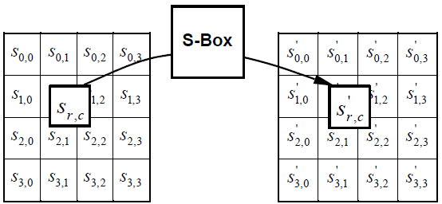
AES: SubBytes
Byte substitution
Usually a 16 by 16 table
Split byte value into high and low nibble
Byte xy replaced by column x, row y
For example, the value “a0” is replaced by the value in row “a” column “0”
Efficient in software
Can also be calculated on the fly
Good for low-memory hardware

Slide 223
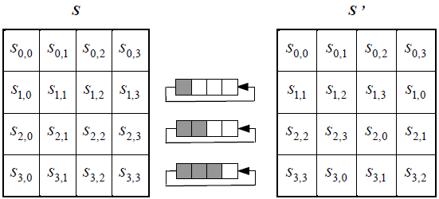
AES: ShiftRows
ShiftRows is about diffusion moving bytes horizontally
Each column is broken up

Slide 224
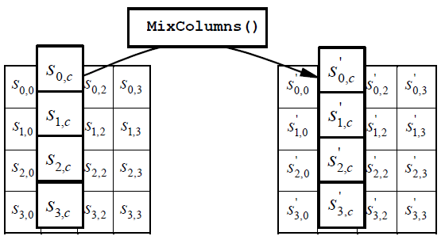
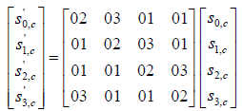
AES: MixColumns
MixColumns is about column diffusion
This is why columns broken up in ShiftRows
Can’t isolate a single column throughout the round
Spread the influence of the bytes
Can be expressed as matrix multiplication
MixColumns is present in all rounds except the last one

Slide 225
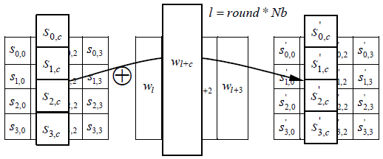
AES: AddRoundKey
Byte by byte xor of key and state
Key is stored in a 2d array as well
Simply treat each column as a matrix, and add the appropriate column from the key schedule

Slide 226
Integral attack on 4 rounds of AES
Set all but 1 byte of the plaintext to an identical fixed value
Create a set of 256 plaintexts such that the variable byte takes on all 256 values
Request the encryptions of all 256 plaintexts, and obtain a set of 256 ciphertexts
Guess one byte of the last round key, and set all other bits to 0
Decrypt the last round of all ciphertexts using the candidate round key
For each byte of state, calculate the xor sum of each byte across the 256 states
If the sum is not 0, discard it
Otherwise, it is a still a candidate

Slide 227
Visual description
Round 1
Suppose we try all possible values for the first byte, and leave all others constant
A | C | C | C
C | C | C | C
C | C | C | C
C | C | C | C
A | C | C | C
C | C | C | C
C | C | C | C
C | C | C | C
A | C | C | C
C | C | C | C
C | C | C | C
C | C | C | C
subBytes
shiftRows
mixColumns
A | C | C | C
A | C | C | C
A | C | C | C
A | C | C | C
A | C | C | C
A | C | C | C
A | C | C | C
A | C | C | C
addKey

Slide 228
Visual description (continued)
Round 2
At the end, all bytes take on all values
A | C | C | C
A | C | C | C
A | C | C | C
A | C | C | C
A | C | C | C
A | C | C | C
A | C | C | C
A | C | C | C
A | C | C | C
C | C | C | A
C | C | A | C
C | A | C | C
subBytes
shiftRows
mixColumns
A | A | A | A
A | A | A | A
A | A | A | A
A | A | A | A
A | A | A | A
A | A | A | A
A | A | A | A
A | A | A | A
addKey

Slide 229
Visual description (continued)
Round 3 isn’t very interesting to draw, since all bytes will remain all A’s
What is important is that at the end of round 3, all positions have the same sum
S=0
Sum the same position over multiple single-round decryptions
Note that the sum is computed with exclusive-or, since that is the addition operation for this field!
The last round has no MixColumns operation
Only need to guess one byte of the last round key
The one that lines up with the sum you’re computing
S | S | S | S
S | S | S | S
S | S | S | S
S | S | S | S

Slide 230
Only partial decryption necessary
You don’t even need to do a full decrypt of the last round
ShiftRows changes byte positions
You’re only concerned with one byte anyway
You can ignore this
Only two parts are necessary to reverse
Addition of the guessed key byte
Its value through inverse S-box

Slide 231
Finishing the attack
Repeat this process for all 16 bytes of the last round key
Each byte will have approximately two candidates
One of them is the correct byte
2¹⁶ = 65536 full key candidates
So much better than 2¹²⁸
We can iterate through all these quickly
For each full key candidate
Calculate the master key from the last round key
Choose a plaintext-ciphertext pair
Calculate ciphertext’ = encrypt(plaintext, master)
If ciphertext’ == ciphertext, then master is the secret key

Slide 232
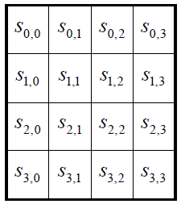
Exercise
Open up “integral.py”
All the AES code you need is there
encrypt(.) encrypts four rounds
backup(.) does a one-round decryption using your guess at the last round key
round2master(.) derives the master key from the last round key
Plaintext and key inputs are 16-element lists
Read into the state column-wise
s[0][0] = p[0], s[0][1] = p[4], s[0][2] = p[8], s[0][3] = p[12]
s[1][0] = p[1], s[1][1] = p[5], s[1][2] = p[9], s[1][3] = p[13],
s[2][0] = p[2], s[2][1] = p[6], s[2][2] = p[10], s[2][3] = p[14],
s[3][0] = p[3], s[3][1] = p[7], s[3][2] = p[11], s[3][3] = p[15]
There is a set of plaintexts and ciphertexts in the code
Objective: find the key that they were encrypted under

Slide 233
Exercise (continued)
You’ll need to fill in the following functions:
Integrate
Given an index (0-15), find the integral for that byte
Integral
Call integrate to find plausible round key bytes
Loop over all plausible round key byte combinations
Derive master key from round key (use round2master())
Tips
Remember, this is an integral where addition means exclusive-or
Pay attention to rows vs. columns

Slide 234
An attack by any other name…
The square attack on AES is very similar
By similar, I mean that it is the exact same thing we just did, but with a different name
The saturation attack on AES is also very similar
Hang on, this is the same attack again!
People sometimes rename things
Here’s why this attack has (at least) three names
AES is based on Square block cipher, which has this attack
Hence “square attack”
A plaintext byte takes on all values
That byte is “saturated”
Hence “saturation attack”
The ciphertext bytes are summed, which is a discrete integration
Hence “integral attack”
They are all the same in this case, but not in general

Slide 235
Summary: symmetric attacks
Generic attacks that can be applied to any block cipher
Time-memory trade-off
Slide attacks
Only works if transforms repeat
Targeted attacks
Specific to a cryptosystem
Linear
Approximate function with linear expressions
Differential
Use expected difference characteristics
Integral
Correct key results in expected sum

Slide 236
Closing remarks
Over so soon?

Slide 237
Summary
Cryptanalysis is the art and science of code breaking
Modern ciphers are either symmetric or asymmetric
Require different attack strategies
Covered asymmetric attacks
Generic attacks on asymmetric systems built on factoring
Pollard’s rho
Pollard’s p-1
Specific attacks on RSA
Generic attacks on asymmetric systems built on the discrete log problem
Pollard’s rho
Index calculus

Slide 238
Summary (continued)
Covered symmetric attacks
Hellman’s time-memory trade-off
Slide attacks
Linear cryptanalysis
Differential cryptanalysis
Integral cryptanalysis on four-round AES
I hope everyone had a good time and comes back for more! ☺

